Slide 1
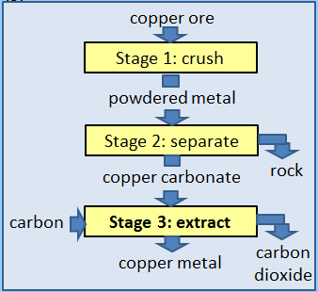
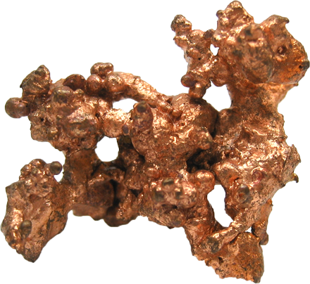
GCSE Subject Area – Chemistry
Extracting copper
The equation for the reaction in Stage 3 is:
2 CuCO₃ + C → 2 Cu + 3 CO₂
From the symbol equation a company calculated that 247 tonnes of copper carbonate are needed to produce 127 tonnes of copper and 132 tonnes of carbon dioxide are released.
Calculate the mass of carbon needed to make 127 tonnes of copper.
127 + 132 = 259
259 – 247 = 12
Subtract this mass from the total
Add the masses together
CuCO₃ C Cu CO₂
copper carbonate + carbon → copper + carbon dioxide
247 tonnes ........ tonnes 127 tonnes 132 tonnes
12
The total mass on each side of the equation must be equal
AQA June 2015 Unit 1

Slide 2
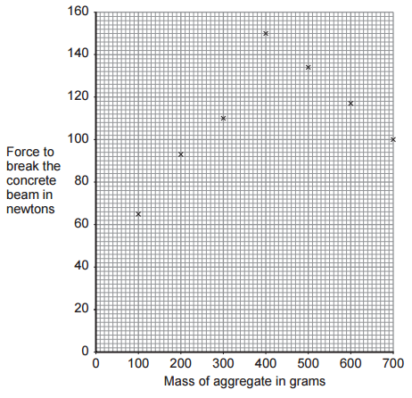
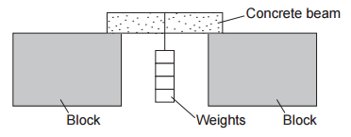
GCSE Subject Area – Chemistry
Testing the strength of concrete
Concrete is made by mixing cement with water, sand and aggregate (small pieces of rock).
A group of students did an investigation on the amount of aggregate needed to make
the strongest concrete beam.
The students’ results are plotted on a graph.
One of the points is anomalous.
Complete the graph by drawing two straight lines of best fit
Anomalous point – it does not fit the pattern
Value between 35 and 40
What force is needed to break a concrete beam containing no aggregate?
AQA June 2015 Unit 1

