Slide 1
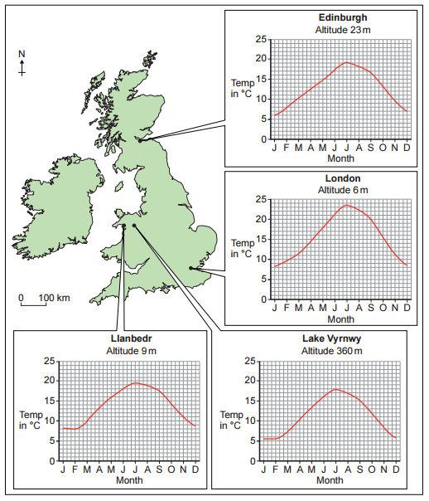
GCSE Subject Area – Geography (Physical Geography)
The temperature at Lake Vyrnwy in January was ................................... °C.
The warmest place in July was ................................... .
The temperature range in London was ................................... °C.
5.5
London
15 - 15.5
AQA June 2015 Unit 1
Notes:
Get the students to match up the methods with their graphical forms first. Encourage them to think about the difference between a histogram and a bar chart. See if any of them can name the remaining chart – a pictogram / pictograph.

Slide 2
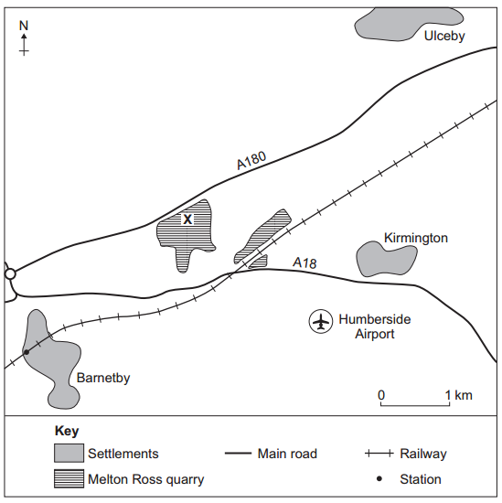
GCSE Subject Area – Geography (Physical Geography)
Melton Ross quarry is two km .................................. of Kirmington.
Barnetby station is .................................. km south west of location X at the quarry.
The quarry is north of the main road the ..................................
West
3.0
A18
AQA June 2015 Unit 1
Notes:
Get the students to match up the methods with their graphical forms first. Encourage them to think about the difference between a histogram and a bar chart. See if any of them can name the remaining chart – a pictogram / pictograph.

Slide 3
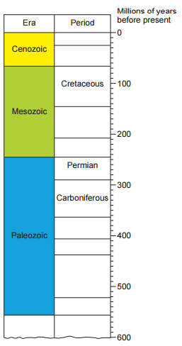
GCSE Subject Area – Geography (Physical Geography)
Some granite formed 280 million years ago in the ...................................... Period.
The Carboniferous period lasted for
................... million years.
Permian
72-75
AQA June 2015 Unit 1
Notes:
Get the students to match up the methods with their graphical forms first. Encourage them to think about the difference between a histogram and a bar chart. See if any of them can name the remaining chart – a pictogram / pictograph.

Slide 4
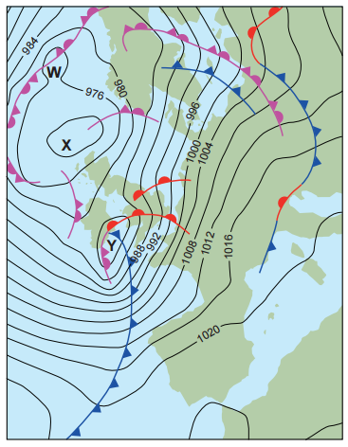
GCSE Subject Area – Geography (Physical Geography)
Circle the correct answer in each set of brackets.
The lowest pressure on the map is at [ W / X ].
The air pressure at Y is between
[ 977 and 979 / 981 and 983 ] millibars.
The isobars to the south of the British Isles are [ close together / far apart ].
There is a [ warm / cold ] front over
southern England.
AQA June 2015 Unit 1
Notes:
Get the students to match up the methods with their graphical forms first. Encourage them to think about the difference between a histogram and a bar chart. See if any of them can name the remaining chart – a pictogram / pictograph.

