Slide 1
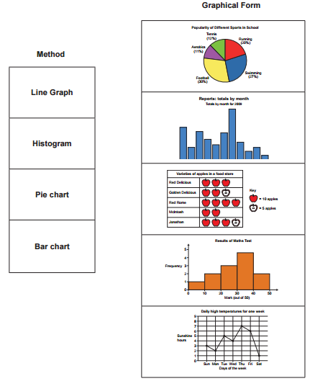
GCSE Subject Area – Design and Technology (Graphic Products)
Match the method of representing data with its graphical form:
There are no gaps between the bars in a histogram. The bars are often, but not always, different widths.
Histograms deal with continuous grouped data.
Bar charts should have equal sized gaps between the bars.
Line graphs are good at showing trends in data over time.
AQA June 2015 Unit 1
Notes:
Get the students to match up the methods with their graphical forms first. Encourage them to think about the difference between a histogram and a bar chart. See if any of them can name the remaining chart – a pictogram / pictograph.

Slide 2
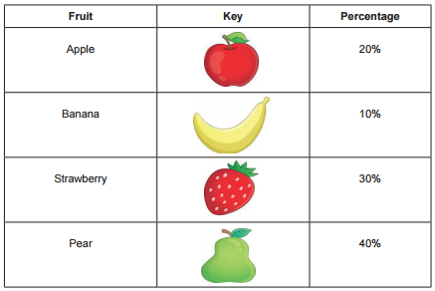
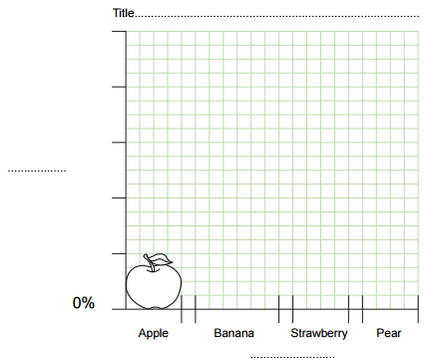
GCSE Subject Area – Design and Technology (Graphic Products)
Complete the pictograph using the data in the table:
AQA June 2015 Unit 1
Notes:
Discuss what you need to do to get full marks – scale and label the axes, give a title, draw the shapes accurately…

Slide 3
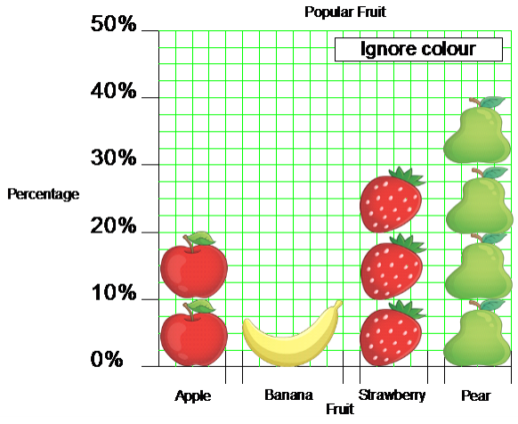
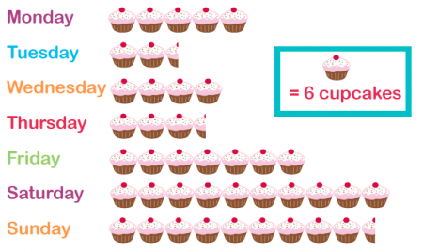
GCSE Subject Area – Design and Technology (Graphic Products)
DT – exemplar answer for full marks
What could the differences with a pictograph / pictogram in Mathematics be?
It would have a key
The same shape / symbol would normally be used for each fruit
There wouldn’t normally be a scale – you would use the key to work out how much of each fruit you had
AQA June 2015 Unit 1
Notes:
Discuss what you need to do to get full marks – scale and label the axes, give a title, draw the shapes accurately…

Slide 4
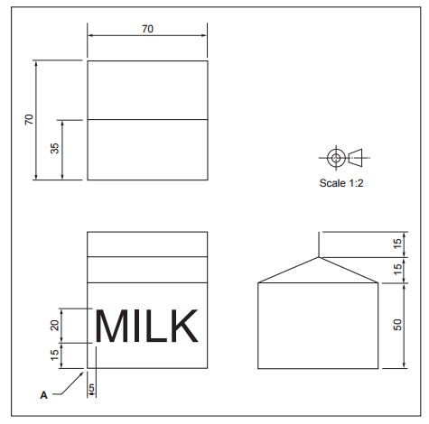
GCSE Subject Area – Design and Technology (Graphic Products)
An orthographic drawing of a milk carton is shown. Dimensions are in mm.
Complete a full size one point perspective of the milk carton:
AQA June 2015 Unit 1
Notes:
Discuss what orthographic means. (Drawn from 3 views – in Maths we refer to front and side elevations, and plan view)
Discuss what the VP stands for – Vanishing point – explain how this is used in art to give drawings perspective.

Slide 5
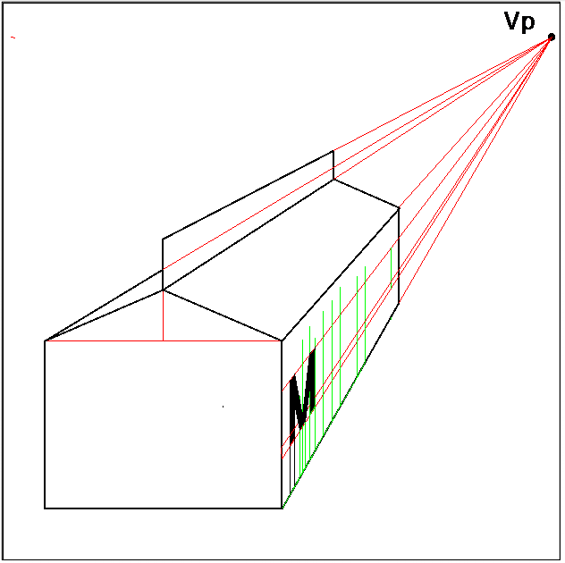
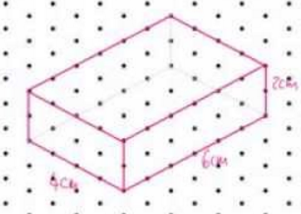
GCSE Subject Area – Design and Technology (Graphic Products)
An orthographic drawing of a milk carton is shown. Dimensions are in mm.
Complete a full size one point perspective of the milk carton:
How is this different from an isometric drawing in Maths?
In isometric drawings the lines are never horizontal. They are vertical or at 60º to the vertical.
AQA June 2015 Unit 1
Notes:
Discuss what orthographic means. (Drawn from 3 views – in Maths we refer to front and side elevations, and plan view)

