Slide 1
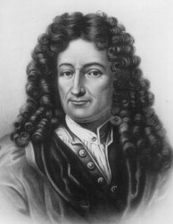
'Music is the pleasure the human mind experiences from counting without being aware that it is counting‘
Gottfried Leibniz (17th Century Philosopher)

Slide 2
DJs like Calvin Harris need to use the mathematical part of their brains when they are mixing different tracks together.
Different tracks will have a different number of beats per minute.
They will also have different rhythms within them.
DJs need to be able to work out how to best fit different tracks together so that the change between them goes smoothly.

Slide 3
Fractions are extremely important when it comes to rhythm.
A semibreve is a whole note.
Do you know what fraction of a note each of these is worth?
Minim
½
Quaver
1
8
Semiquaver
1
16
Crotchet
¼
How many minims in a semibreve? How many semiquavers in a semibreve?

Slide 4
Semibreve | Minim | Crotchet | Quaver | Semiquaver
1 | ½ | ¼ | 1 8 | 1 16
1
½
½
¼
¼
¼
¼
1
8
1
8
1
8
1
8
1
8
1
8
1
8
1
8
1
16
1
16
1
16
1
16
1
16
How many crotchets are there in a minim? Could you write this as a fraction sum?
What other musical fraction sums could you make?
+
=
¼ + ¼ = ½

