Slide 1
How many of these can you unjumble to make words connected to transformations?
I N F L E C T O R E
L E A F S C R O T A C
S T R O A L I N A N
A N I T O R O T
T R E N E C
T R E V O C
G L E A N
S W I C E L O C K
M E G A T R E N L E N
R O N I R L I M E R

Slide 2
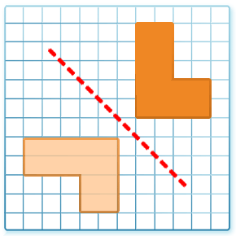
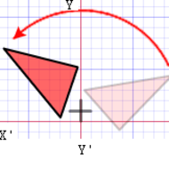
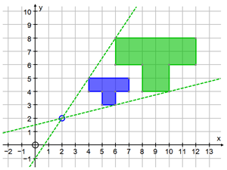
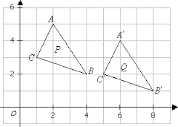
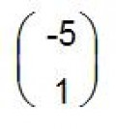
Need a hint?
Each picture leads to at least one of the words, some pictures lead to three.

Slide 3
How many of these can you unjumble to make words connected to transformations?
I N F L E C T O R E
L E A F S C R O T A C
S T R O A L I N A N
A N I T O R O T
T R E N E C
T R E V O C
G L E A N
S W I C E L O C K
M E G A T R E N L E N
R O N I R L I M E R

