Slide 1
Year 7 Mathematical Literacy Assessment

Slide 2
Why are we doing this test?
This test will help us understand how well you know Mathematical words.
If we understand what words you don’t know, we can make sure we teach you them.
If you know the words you need to, you will be able to understand them when they come up in questions.
If you understand the questions, you will do better in assessments.

Slide 3
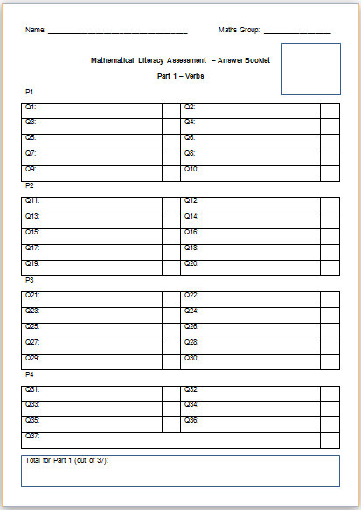
Use a black or blue pen to answer the test.
Write your name and your Maths group at the top of the Answer Booklet.

Slide 4
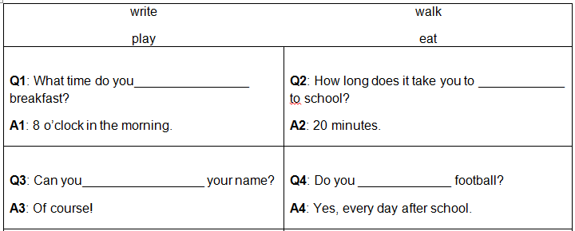
Examples
eat
walk
write
play

Slide 5
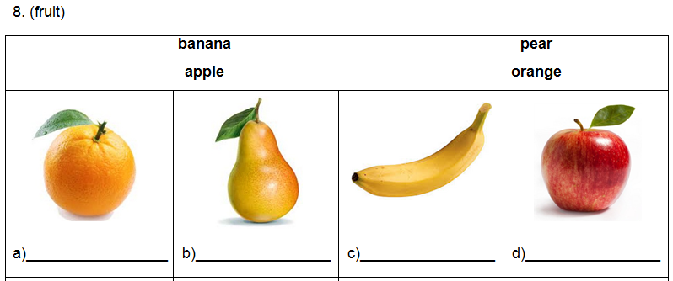
Examples
orange
pear
banana
apple

Slide 6
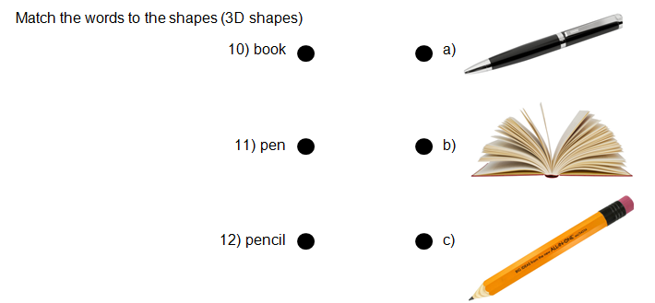
Examples
b
a
c

