Slide 1
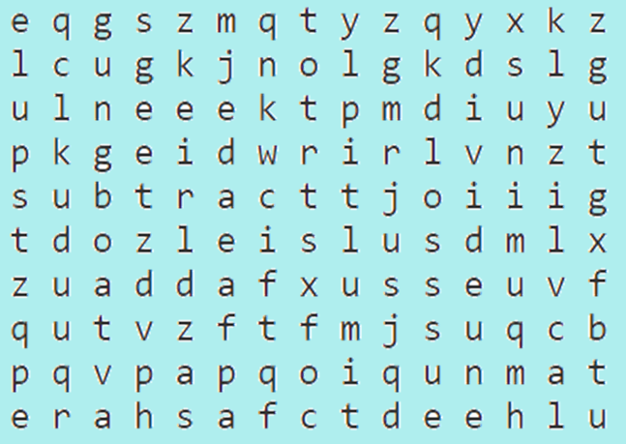
How many words can you find connected to:
x or + or – or ÷

Slide 2
How many words can you find connected to:
x or + or – or ÷
add (+)
difference (-)
divide (÷)
minus (-)
multiply (x)
plus (+)
product (x)
quotient (÷)
share (÷)
subtract (-)
sum (+)
times (x)
total (+)

