Slide 1
How many of these can you unjumble to make the names of pieces of mathematical equipment?
E L R R U
C E L A S S
C I N L E P
M O T H R E M R E T E
T R O P R A T O R C
R E C T I L M O N E
R I P A F O S C A M P E S O S
L O R A T L A C C U
T S U Q S E E R A
N E P

Slide 2
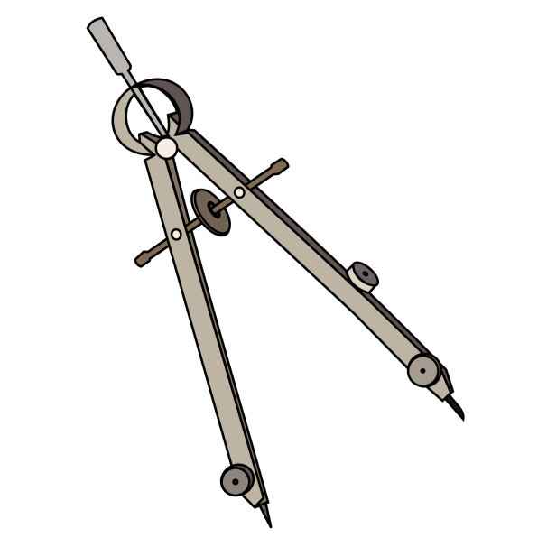
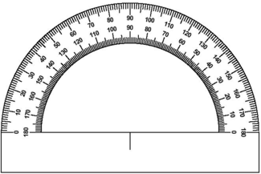
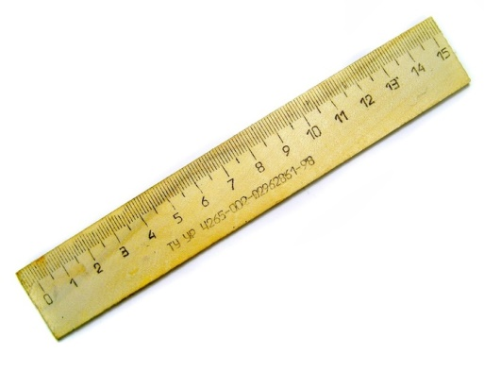
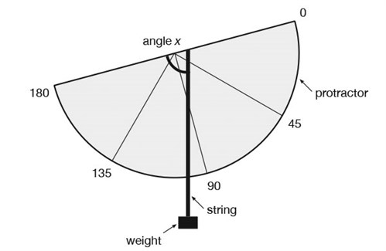
Need a hint?

Slide 3
How many of these can you unjumble to make the names of pieces of mathematical equipment?
E L R R U
C E L A S S
C I N L E P
M O T H R E M R E T E
T R O P R A T O R C
R E C T I L M O N E
R I P A F O S C A M P E S O S
L O R A T L A C C U
T S U Q S E E R A
N E P

