Slide 1
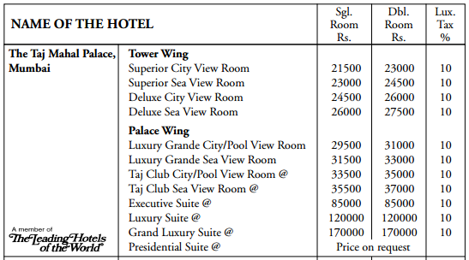
Taj Mahal Palace Hotel, Mumbai
How much would it cost you to stay in their cheapest single room for 2 nights?
1 rupee ≈ 0.01 pounds
How much would it cost to stay in their second most expensive double room for a week?

Slide 2
Taj Mahal Palace Hotel, Mumbai
How much would it cost you to stay in their cheapest single room for 2 nights?
1 rupee ≈ 0.01 pounds
21500 x 2 = 43000
43000 + 4300 = 47300 Rs. = £473
How much would it cost to stay in their second most expensive double room for a week?
170000 x 7 = 1190000
1190000 + 119000 = 1309000 Rs. = £13090

