Slide 1
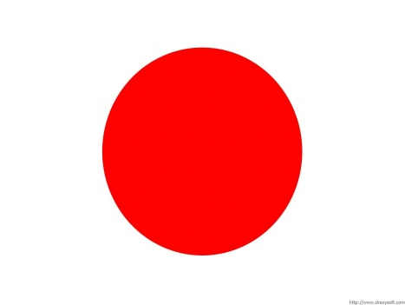
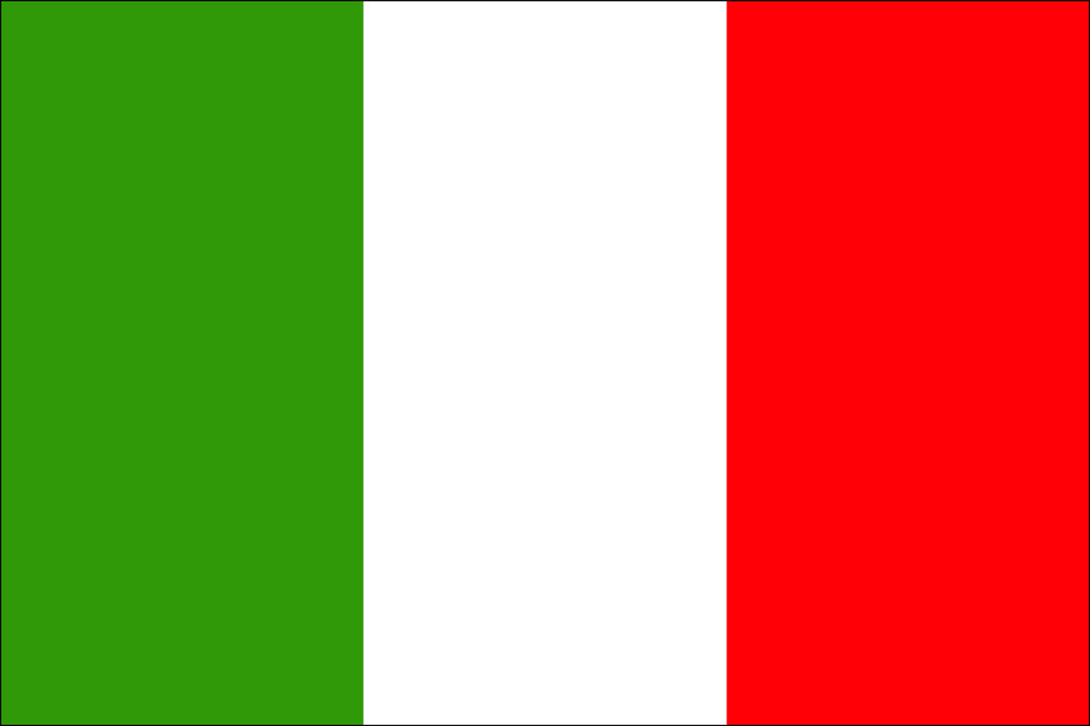
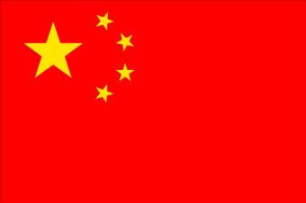
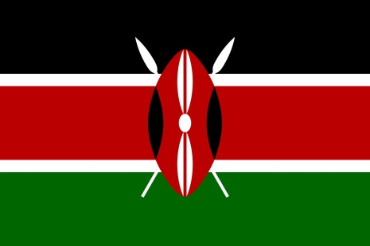
Counting in different languages
Wherever you go in the world, numbers are an essential part of everyday life.
Today you are going to learn to count to 10 in a different language.
Click on the flags to choose the language you would like to learn.
Japanese
Italian
Chinese
Swahili

Slide 2
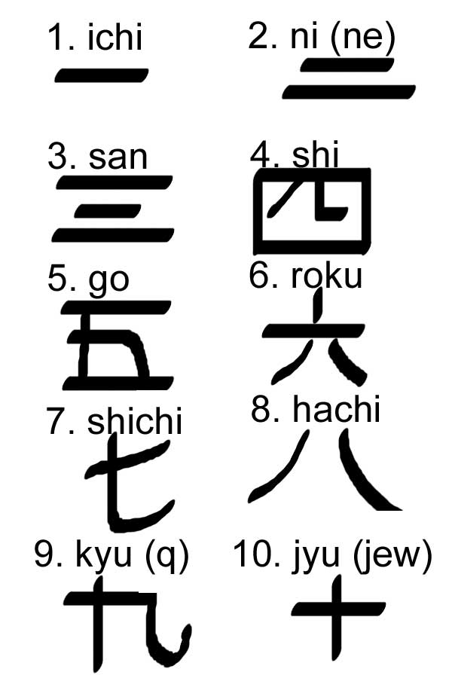
The Japanese language is spoken by more than one hundred and thirty million people. It can be written using 4 different scripts: romaji, katakana, hiragana and kanji.
Back to start

Slide 3
Around 59 million people speak Italian as their first language.
Italian originates from Latin – the language spoken in ancient Rome.
Back to start

Slide 4
Mandarin Chinese is the most spoken language in the world – with over 935 million people claiming it as their first language.
Back to start

Slide 5
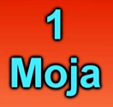
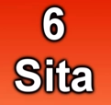
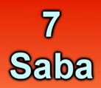
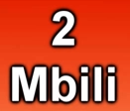
Over 26 million people speak Swahili as their first language. It is mainly spoken in East Africa – in the countries of Kenya, Tanzania and Uganda.
Back to start

