Slide 1
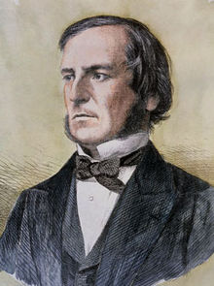
Boolean Logic
Computer programs are often used to compare or order data. Boolean logic is a way of doing this.
It uses the following symbols to compare variables.
What do these symbols mean?
=
Equals
This is George Boole
>
Greater than
He was an English Mathematician who lived from 1815 to 1864.
<
Less than
>=
Greater than or equal to
Boolean Logic is named after him and is widely used in computer programming.
<=
Less than or equal to
<>
Does not equal

Slide 2

Boolean Logic
Within a computer program, Boolean logic uses algebra.
For a given statement it compares 2 values, and then gives a Boolean value of TRUE or FALSE.
What Boolean values would be given for the following statements?
If x = 7 and y = 12
If x = 10 and y = 10
x = y
FALSE
x = y
TRUE
x > y
FALSE
x > y
FALSE
x < y
TRUE
x < y
FALSE
x >= y
FALSE
x >= y
TRUE
x <= y
TRUE
x <= y
TRUE
x <> y
TRUE
x <> y
FALSE

