Slide 1

Algorithms
An algorithm is basically a way for a computer to solve a problem.
START
Input
‘What 2D shape has an infinite number of lines of symmetry?’
Flow charts can be used to plan your algorithm and hence your computer program.
Look at this algorithm, what is the missing word?
NO
Output
‘Try again!’
Does answer = ‘circle’?
?????
YES
Output
‘Correct!’
STOP

Slide 2
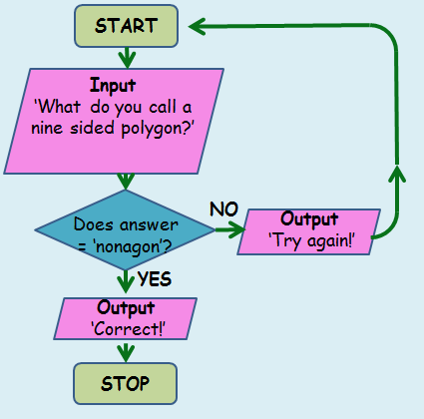
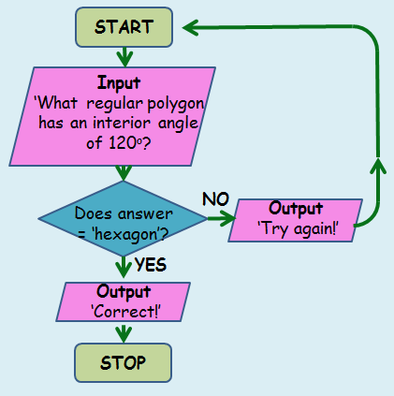
Algorithms
How about for these algorithms?
?????
?????

