Slide 1
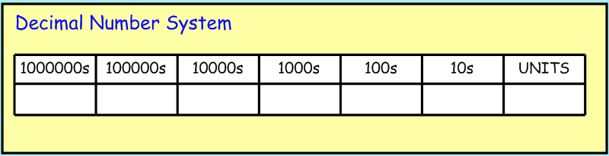
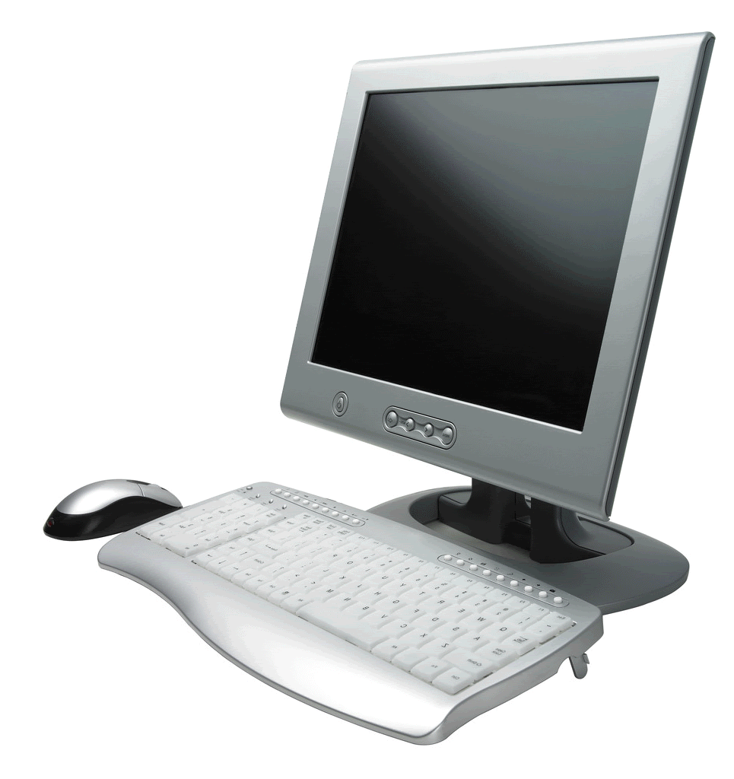
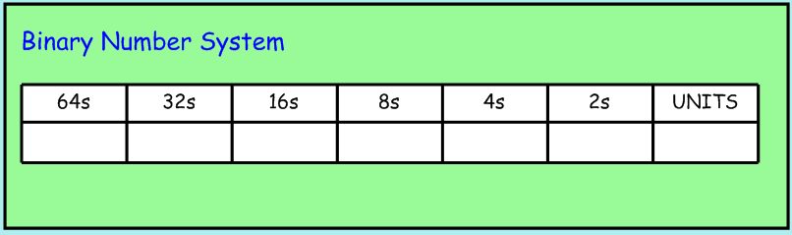
Binary
Binary is a counting system that only uses the digits “1” and “0”.
This is great for computer programs, as it means you only need two states, on or off, to communicate information.
In the decimal system, each place value is a power of 10.
2 x 10000
0 x 1000
2 x 100
0 x 10
5 x 1
2
0
2
0
5
For example, twenty thousand, two hundred and five.
In the binary system, each place value is a power of 2.
1 x 16
0 x 8
1 x 4
1 x 2
0 x 1
1
0
1
1
0
For example, twenty two.

Slide 2
Binary
What are these numbers (given in Binary) in our decimal system?
100
4
1001
9
111
7
10001
17
1110010
114
10000000
128

