Slide 1
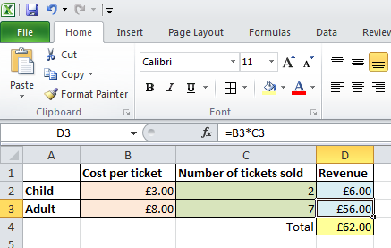
Spreadsheet Calculations
Spreadsheets are widely used in business to carry out financial calculations.
Once a spreadsheet is set up, it is easy to alter the numbers in it to carry out future calculations.
This spreadsheet is being used to calculate the revenue from ticket sales.
The cell highlighted has the program “=B3*C3” in it. This means that it will work out the value of the number in B3 multiplied by the number in C3 and place it in the cell indicated. In this case £8 x 7 = £56

Slide 2
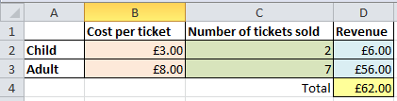
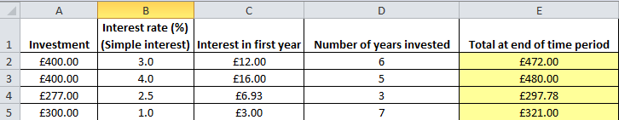

Spreadsheet Calculations
Look at the spreadsheet again. Can you work out what programs (calculations) have been written in the cells indicated?
How about for this one? (NB – Simple, not compound interest)

