Slide 1
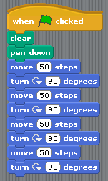
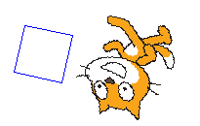
Drawing polygons in Scratch
Scratch is a really useful computer software package that allows you to write different computer programs.
One of the types of program you can write lets you draw 2D shapes. Any 2D shape with 3 or more straight sides is known as a polygon.
What polygon do you think the program on the left would draw?
Each time the Sprite changes direction it turns through 90º. This is the exterior angle of the polygon.
90º
Square
4 x 90 = 360⁰ (A full turn)

Slide 2
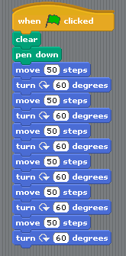
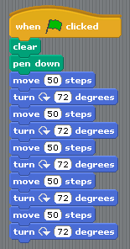
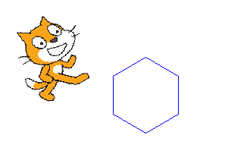
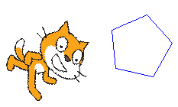
Drawing polygons in Scratch
Can you work out what polygons these programs draw?
6 x 60 = 360⁰ (A full turn)
5 x 72 = 360⁰ (A full turn)
Hexagon
Pentagon

