Slide 1
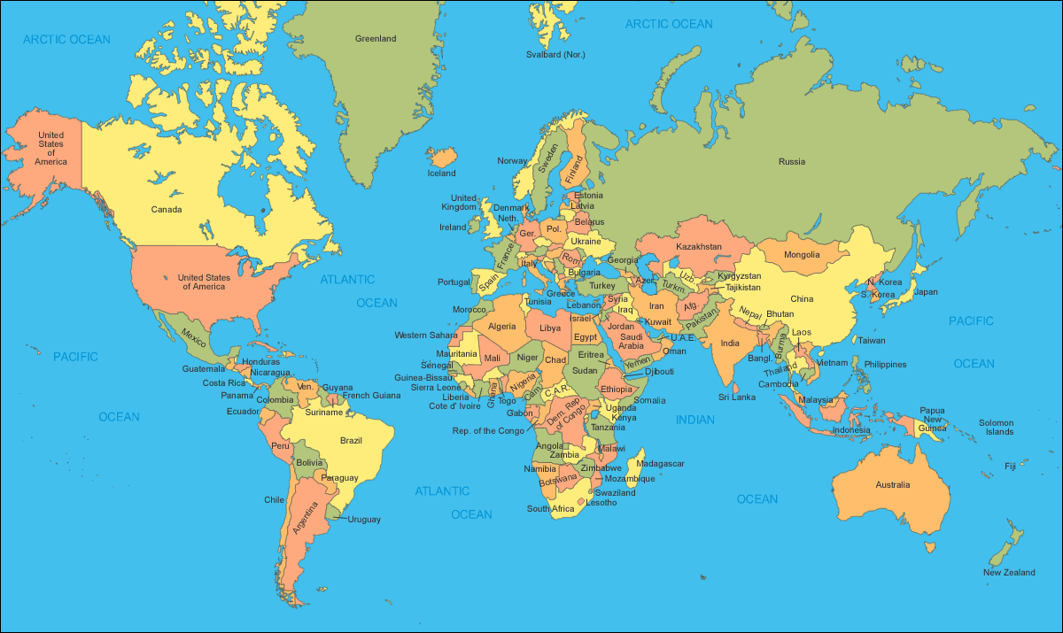
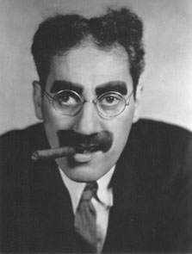
The truth about British weather
Britain has a reputation abroad for really bad weather. Is this fair?
How do you think our weather compares to that of other countries?
“I'm leaving because the weather is too good.
I hate London when it's not raining.”
Groucho Marx
(1890 – 1977)

Slide 2
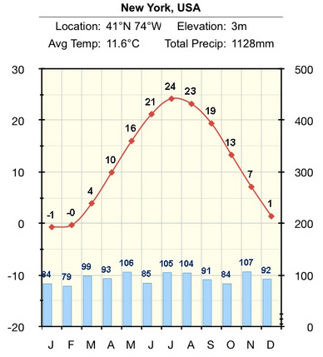
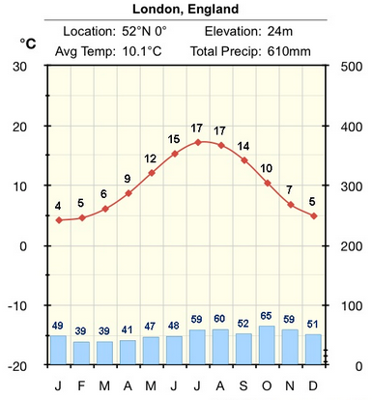
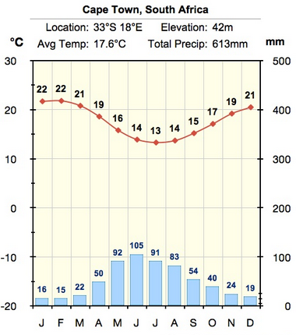
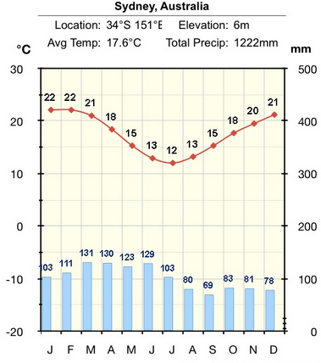
If we compared the rainfall and temperature in these 4 cities across the world, what would you expect?
London
New York
A way to do this is to look at climate graphs.
What do you notice?
Compare the graphs.
Does anything surprise you?
Cape Town
Sydney

