Slide 1
Roman Numerals
This is the entrance to the Colosseum in Rome.
If you look carefully you can see the numbers around the entrance.
The Romans used a number system based on the following symbols.
I
V
X
L
C
D
M
Any idea what they’re worth?
1
5
10
50
100
500
1000

Slide 2
How to read Roman Numerals
A letter repeats its value that many times (XXX = 10+10+10 = 30, CC = 100 + 100 = 200, etc.). A letter can only be repeated three times.
If one or more letters are placed after another letter of greater value, add that amount. VI = 6 (5 + 1 = 6) LXX = 70 (50 + 10 + 10 = 70) MCC = 1200 (1000 + 100 + 100 = 1200)
If a letter is placed before another letter of greater value, subtract that amount. IV = 4 (5 – 1 = 4) XC = 90 (100 – 10 = 90) CM = 900 (1000 – 100 = 900)

Slide 3
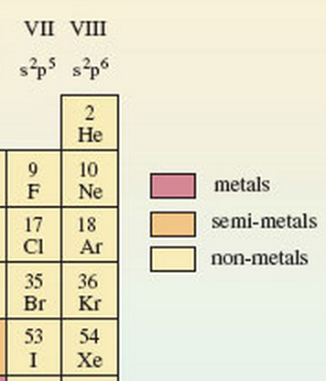
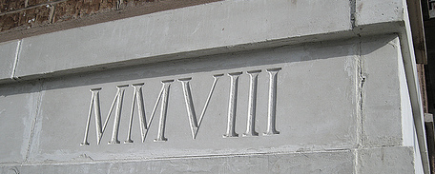
Roman numerals are still used today.
Can you read them in these modern examples?
Pope Benedict XVI

Slide 4
Roman numerals are still used today.
Can you read them in these modern examples?
8
Pope Benedict XVI
2004
16
12
2008

