Slide 1
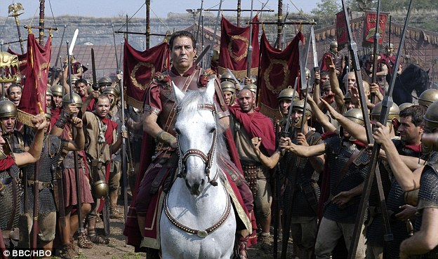
Code breaking
Codes have been used for thousands of years to communicate battle plans and tactics without the enemy finding out.
How would Caesar have communicated the message below to his generals?
Julius Caesar had a code where he used the letter that came 3 places on in the alphabet instead.
Instead of A he would write D and so on.
Caesar’s message | Coded message
A
T
T
A
C
K
D
W
W
D
F
N

Slide 2
What do these messages from Caesar to his generals mean?
hqhpb dssurdfklqj
uhwuhdw wr iruhvw
Enemy approaching
Retreat to forest
Can you write your own coded messages to each other using Caesar’s code?
wkluwb ghdg
Thirty dead

