Slide 1
On the 5th November 1605, Guy Fawkes was discovered under the House of Lords with several barrels of gunpowder. He was preparing blow up the building on the opening of parliament that day.
Since that day the fact that he didn’t manage to blow up the government has been celebrated on the 5th November with fireworks and bonfires.
How many years ago was Guy Fawkes discovered? How did you work it out?
1605 2013
+95
+300
+13
1700
2000
95 + 300 + 13 OR 2013
= 408 - 1605
(Use column addition if it’s easier) 408

Slide 2
Here are some other interesting dates.
Can you work out how many years ago these things happened? (Use your green books to work them out)
Every year Americans celebrate Thanksgiving on the 4th Thursday in November in memory of the first successful harvest the pilgrims had after they arrived on the continent. The first thanksgiving was in 1621.
On the 4th November 1843 the statue of Lord Nelson was put on top of Nelson’s column in Trafalgar Square, London where it still stands today.
On the 17th November 1558, Queen Mary (Tudor) died. She was England’s first ruling queen and daughter of Henry VIII.
Ready for the answers?

Slide 3
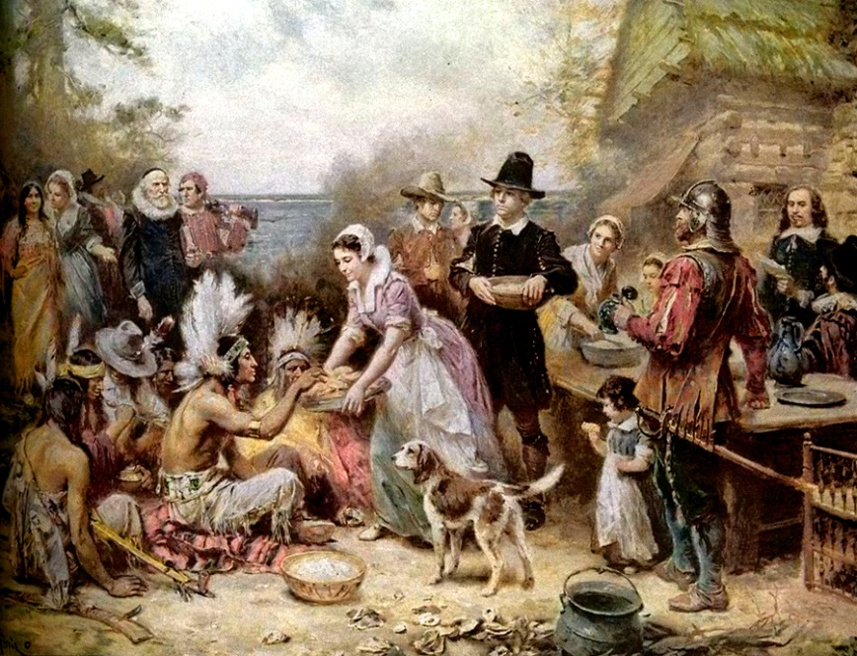
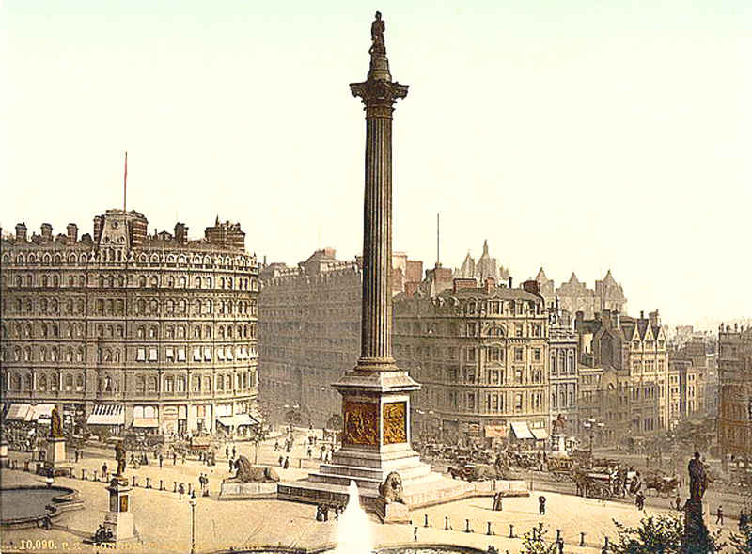
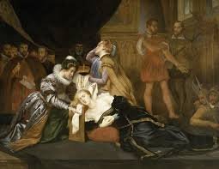
The first thanksgiving in 1621 was 392 years ago.
Nelson’s column was erected 170 years ago in 1843.
Queen Mary I died 455 years ago in 1558.

