Slide 1
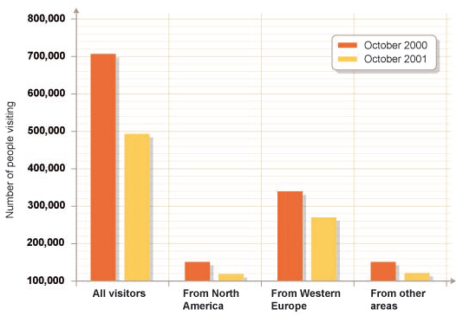
Bar Charts
This is a comparative bar chart.
What does it tell you? What could have caused this?
The terror attack in September 2001 led to a decline in tourism to the UK.

Slide 2
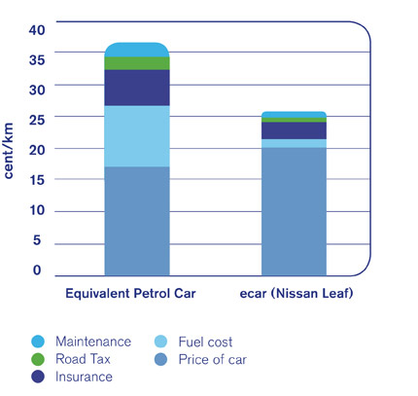
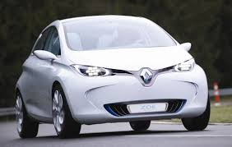
Bar Charts
This is a stacked bar chart.
What does it tell you?
This bar chart is on a website advertising electric cars.
It aims to show the savings you would make in running costs if you switched to using an electric car.
Where would you make the biggest savings in running costs?

