Slide 1
Employment Types
Below are the three main employment types.
Can you think of examples of each?
Primary
(Getting raw materials)
Secondary (Processing raw materials)
Tertiary (The service sector)
Health service
Mining
Heavy manufacturing
Transportation
Farming
Light manufacturing
Fishing
Food production
Education
Oil refining
Entertainment
Energy production
Tourism
Finance
Retail

Slide 2
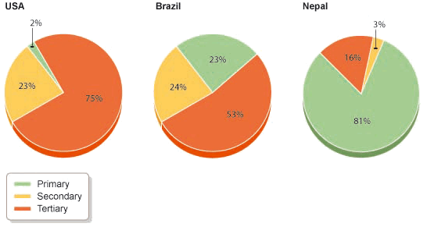
These pie charts show employment types in different countries
The pie chart doesn’t tell you how many people are in each sector, just the percentage of the total population.
A key
Describe what the Pie Charts tell you.
What information must you always remember to include on a Pie Chart?
What information doesn’t each Pie Chart tell you?

Slide 3
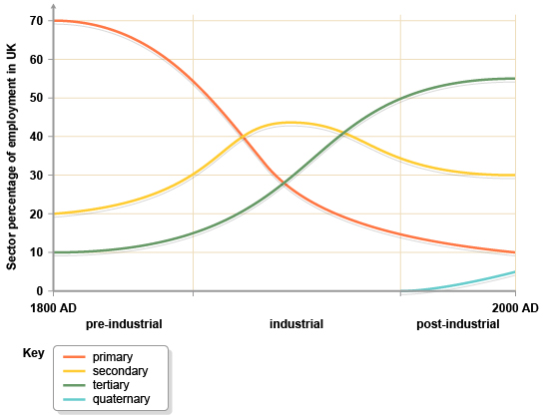
What does this graph show about how employment is changing in the UK? What do you think “quaternary” employment is?

