Slide 1
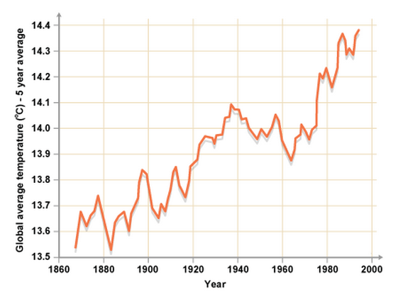
Interpreting line graphs
Line graphs are an extremely useful way of visualising how something changes over time.
What does this line graph show you?
What other situations might be best described using a line graph?

Slide 2
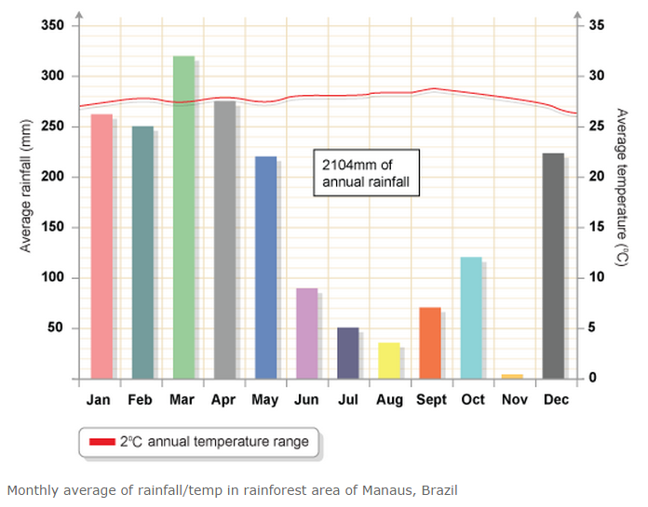
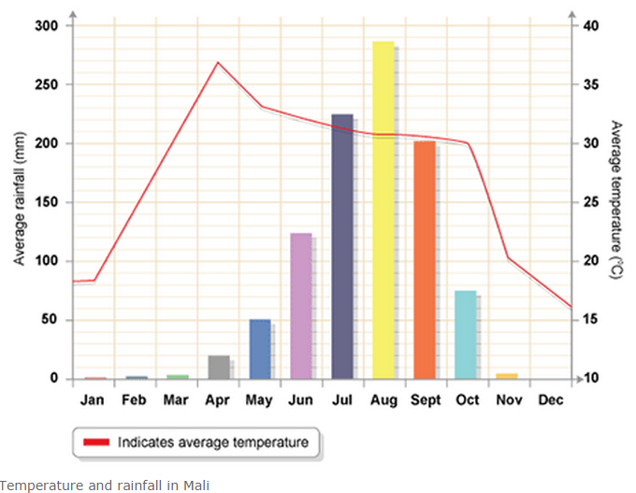
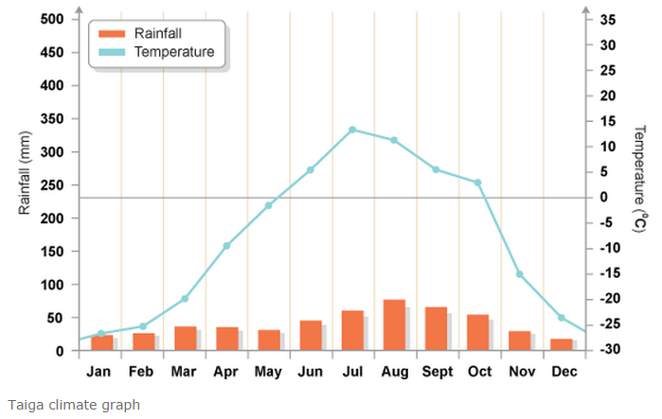
Tropical rainforest
Savannah grassland
These climate graphs allow you to compare the climate in three of the different biomes (large scale eco-systems) of the world.
Coniferous forest
The bar chart shows rainfall while the line graph shows temperature.
Describe the climate in each biome.
Which biome do you think would be easiest to live in? Why?

Slide 3
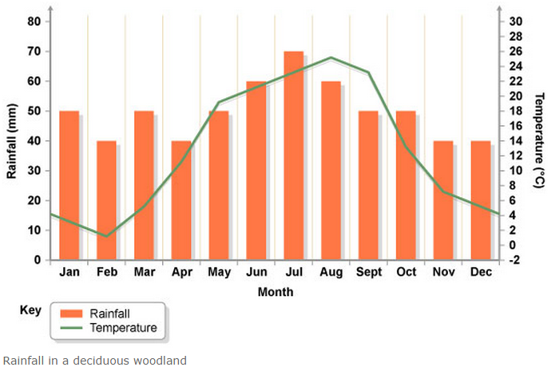
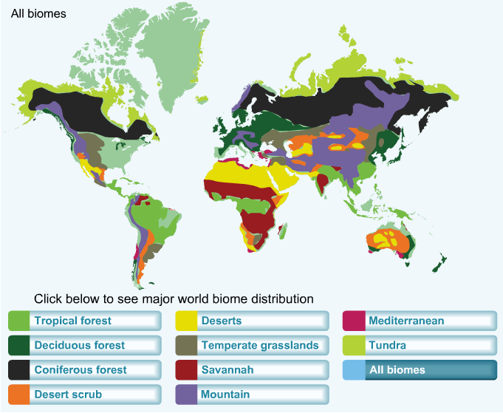
Which biome does our country lie in?

