Slide 1
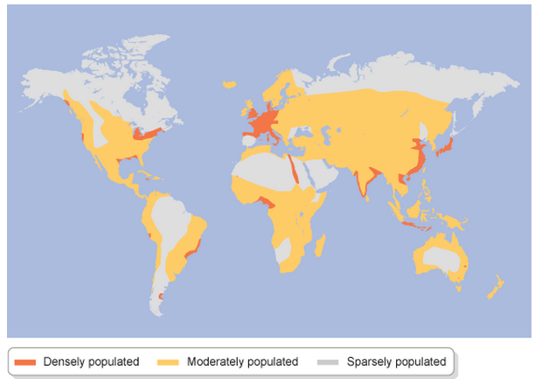
Population Density
Look at the map. Which countries have the highest population density?
Population density tells us the number of people per square kilometre of a country.
How does this compare to the countries with the highest population?

Slide 2
Population Density
Population density = Total population ÷ Total land area (km²)
Look at the table below showing the top ten countries of the world in terms of population.
Which of them has the highest area? Which of them has the lowest area?
China and India both have very large populations, but which has the higher population density? How can you tell this quickly?
Country | Population | Area (km²)
China | 1,366,950,000 | 9,706,961
India | 1,260,070,000 | 3,287,590
USA | 318,804,000 | 9,826,675
Indonesia | 252,164,800 | 1,919,440
Brazil | 203,202,000 | 8,515,767
Pakistan | 188,020,000 | 796,095
Nigeria | 178,517,000 | 923,768
Bangladesh | 157,036,000 | 147,570
Russia | 146,149,200 | 17,098,242
Japan | 127,040,000 | 377,944
Can you estimate (by rounding to nice numbers) the population density of any of these countries?
Example
Population Density (China) ≈
1000000000 ÷ 10000000 = 100

