Slide 1
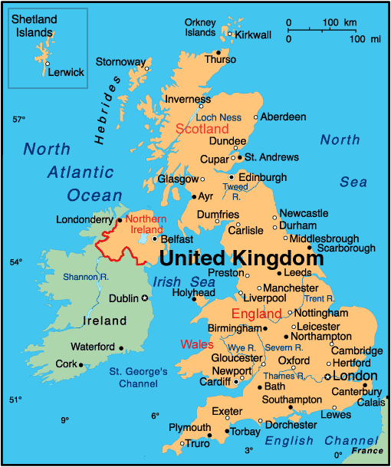
Reading scales on maps
This is a map of the United Kingdom.
In the top right corner is a scale to help you work out how far different places are from each other.
How far do you think Manchester is from London?
About 170 miles.

Slide 2
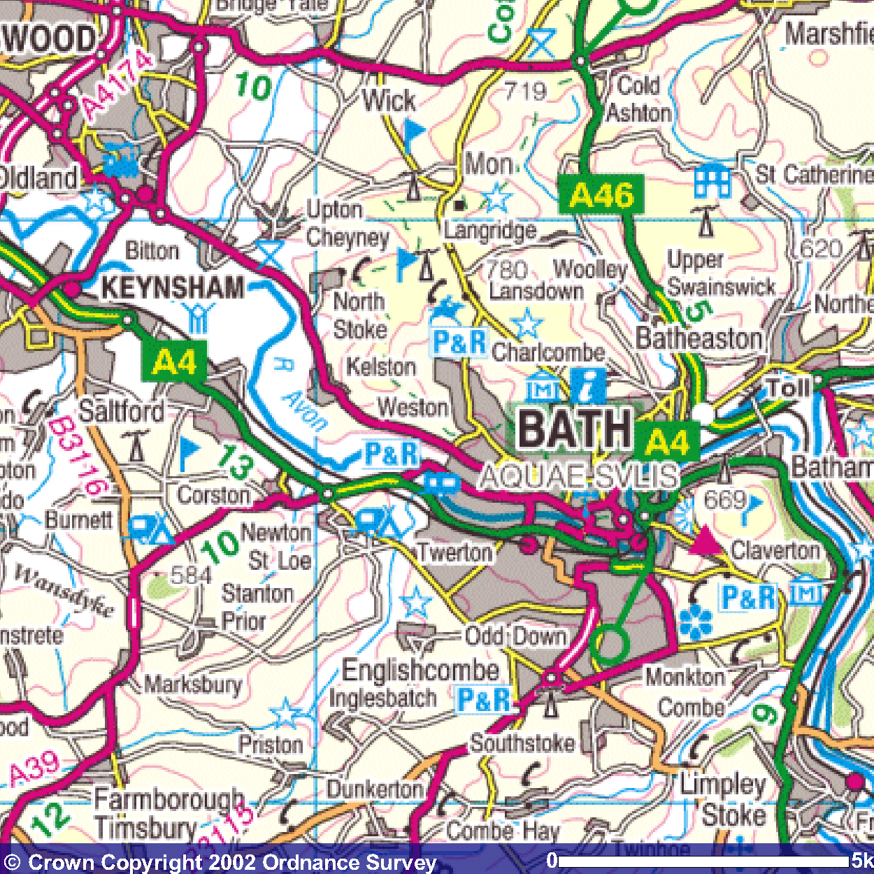
What road would you travel along to get to Keynsham from Bath?
Approximately how far is it from Bath?
Approximately how many miles is this? (5 miles = 8 kilometres)
What towns lie within a 5 kilometre radius of Bath?
Which towns are equidistant from Bath and Keynsham?
How far is the nearest campsite to Bath?

