Slide 1
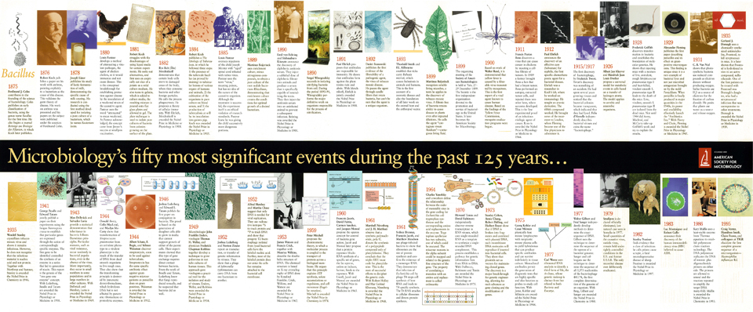
Timelines
Which area(s) of the curriculum might you use timelines in?
Why are they useful?
What numeracy skills do you need to analyse them?
On the next page is a timeline of British History.

Slide 2
In what year did Elizabeth II become queen?
How many years ago was this?
Can you make up your own questions?
How many years ago did Ireland gain independence?
How many years did the cold war last for?
How many years were there between America gaining independence and Ireland gaining independence?

