Slide 1
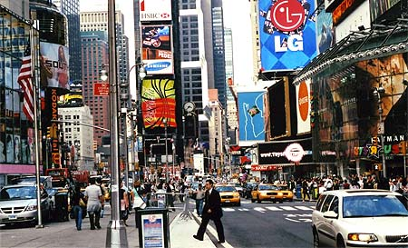
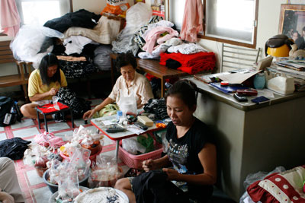
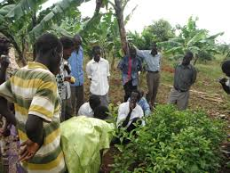
How could you represent economy activity using a graph?

Slide 2
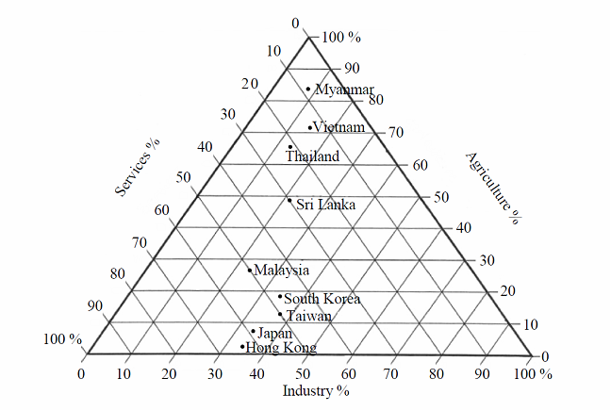
Triangular graphs
Triangular graphs are often used in humanities to describe things.
This graph shows the economy activity of different countries.
The direction of the lines by the numbers shows how to read the graph
JAPAN
8% Agriculture
34% Industry
58% Services
Which countries have 50% of their economic activity as services?

Slide 3
Triangular graphs
Take it in turns to describe the economic activity of different countries.
See who can guess the country first.
Where do you think the UK would lie?

