Slide 1
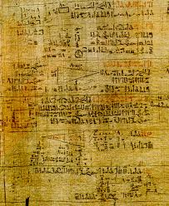
Mathematics in Ancient Egypt
This is part of the Rhind papyrus.
It was produced by the Ancient Egyptians about 1650 BC – that’s over 3500 years ago!
It asks mathematical questions about triangles and shows how the Ancient Egyptians would have used mathematics to design the pyramids.

Slide 2
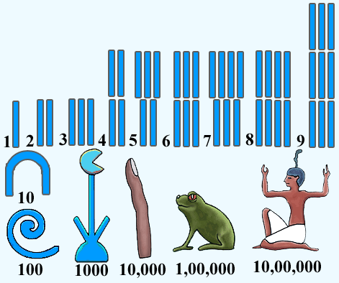
The Ancient Egyptians really excelled in medicine and applied mathematics.
They used a decimal system involving seven different symbols.
Make notes to help you remember these.
Then use your notes to work out what the numbers on the next slide are.

Slide 3
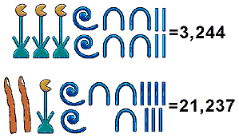
1)
2)
3)

Slide 4
= 1,572

