Slide 1
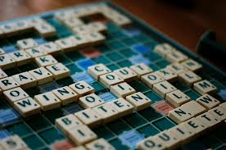
An American Architect, Alfred Butts, came up with the idea for Scrabble in 1938.
Since then over 150 million sets have been sold. The game is also available in 29 different languages.
Players take turns to use their letters to make words on the board.
Each letter is worth a certain number of points – the number of points it is worth is connected to how frequently it is used in the English language.
Extra points can be earned by using special squares on the board that double or triple the score of a letter or word.

Slide 2
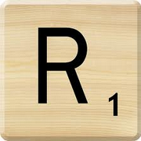
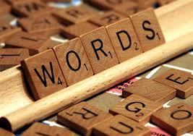
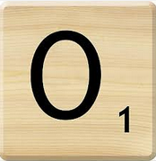
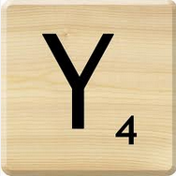
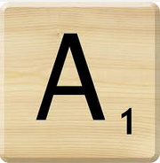
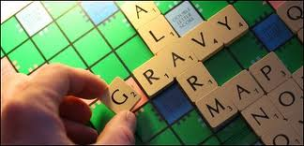
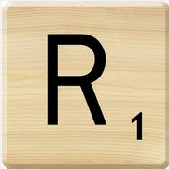
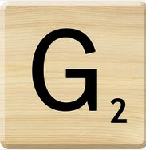
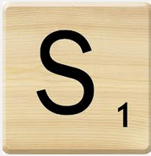
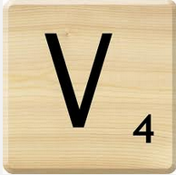
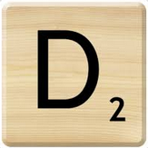
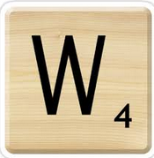
How much would the word “words” score if placed on ordinary squares?
How about the word “gravy”?
(the G is going on a double word score)

Slide 3
Number of tiles in game | Score for letter
12 tiles | E = 1
9 tiles | A = 1 I = 1
8 tiles | O = 1
6 tiles | N = 1 R = 1 T = 1
4 tiles | L = 1 S = 1 U = 1 D = 2
3 tiles | G = 2
2 tiles | B = 3 C = 3 M = 3 P = 3 F = 4 H = 4 V = 4 W = 4 Y = 4
1 tile | K = 5 J = 8 X = 8 Q = 10 Z = 10
This table shows how many of each tile there are in a game of scrabble and what each letter is worth.
Choosing 7 letters, what is the highest scoring word you can come up with?
Remember you can only use a letter more than once if it has more than one tile.

Slide 4
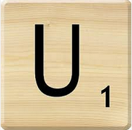
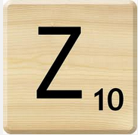
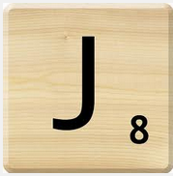
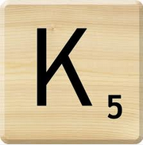
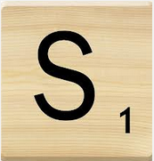
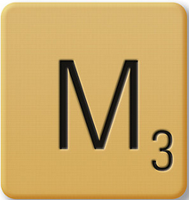
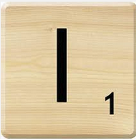
The highest scoring 7 letter word in Scrabble that you could open a game with is…..
Score = 3 + 1 + 10 + 8 + 1 + 5 + 1 = 29
It means “a Russian peasant.”

