Slide 1
Venn Diagrams
Venn diagrams are used to compare and contrast information.
Whatever is common to the groups gets put in the overlapping section.
have hair
live in water
lay eggs
have scales
live birth
have fins
breathe air
can swim
breathe water

Slide 2

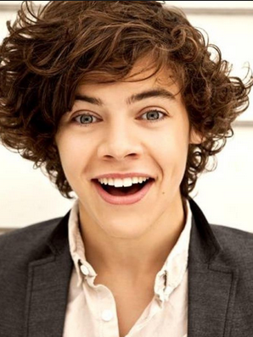
Add adjectives to the Venn Diagram below to compare and contrast these two “Harry”s
magical
musical
male
trustworthy
flirtatious
dark-haired
famous
Harry Potter
Harry Styles
Did you get any others?

