Slide 1
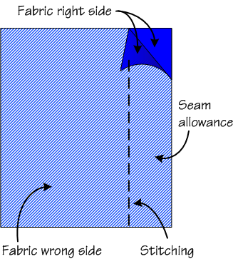
Numeracy and Textiles
When you are cutting out material to make a garment you should include a seam allowance. This is the amount of space you are going to leave between the stitching and the edge of the fabric.
45cm
35cm
Imagine you want to make a cushion with the dimensions above. You decide to leave a 2cm seam allowance. What size piece of fabric should you cut out?

Slide 2
Numeracy and Textiles
2cm seam allowance. What size piece of fabric should you cut out?
2 + 45 + 2 = 49 cm
2cm
2 + 35 + 2 = 39 cm
35cm
2cm
45cm
2cm
2cm

Slide 3
Numeracy and Textiles
Assume a 1.5 cm seam allowance for the following pieces of cloth. What size pieces of fabric should you cut out?
23cm
65cm
18cm
31cm
42cm
33cm
68 cm x 21 cm
26 cm x 34 cm
45 cm x 36 cm

