Slide 1
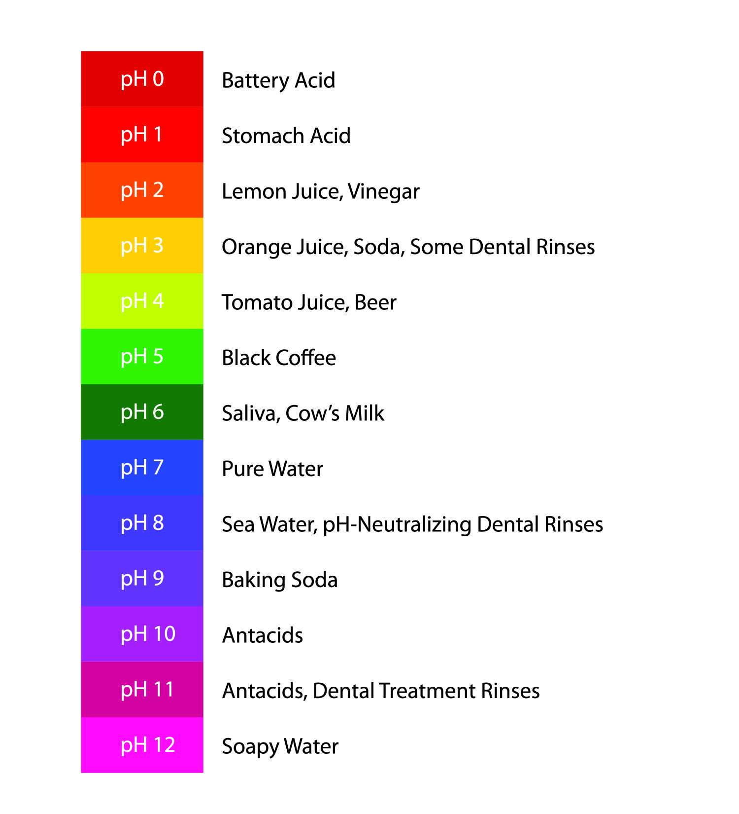
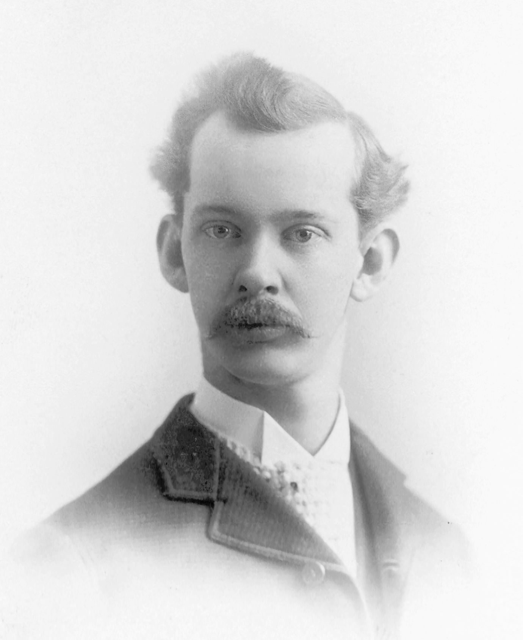
The Scoville Scale
Numerical scales are used in all kinds of places.
You will have used the pH Scale, for example, in science.
But have you heard of the Scoville Scale?
The Scoville Scale was developed by Wilbur Scoville in 1912.
It is a measure of the “hotness” of different chilli peppers or of anything derived from them.

Slide 2
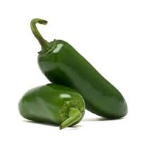
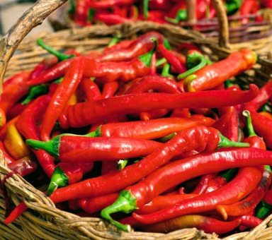
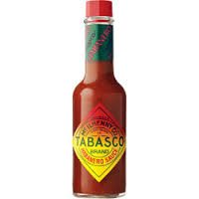
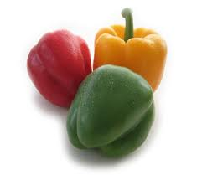
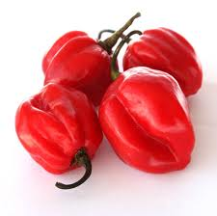
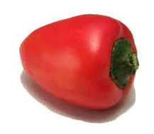
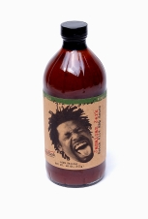
The Scoville Scale
TABASCO® Habanero Pepper Sauce
Jalapeño
Pure capsaicin
Sweet bell pepper
2,500–5,000
16,000,000
7,000-8,000
0
The Scoville scale goes from 0 to 16,000,000 Heat Units.
What Heat Unit rating do you think these have?
Scotch bonnet
Pimento
The Source
Juan Speciality Foods
100,000-325,000
100 – 500
7,100,000

Slide 3
The Scoville Scale
Approximately how many times hotter than pimento is pure capsaicin?
Can you make a comparison between Scotch Bonnet and Jalapeño peppers?
Would you put “The Source” on your food?
TABASCO® Habanero Pepper Sauce
Jalapeño
Pure capsaicin
2,500–5,000
16,000,000
7,000-8,000
Scotch bonnet
Pimento
The Source
Juan Speciality Foods
100,000-325,000
100 – 500
7,100,000

