Slide 1
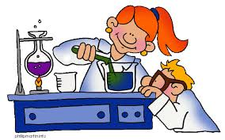
Recognising formulae
A formula gives you a way to work out the value of something given other information.
You use formulae across the curriculum.
Which subjects do you use formulae in?

Slide 2
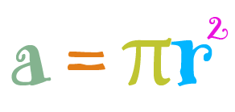
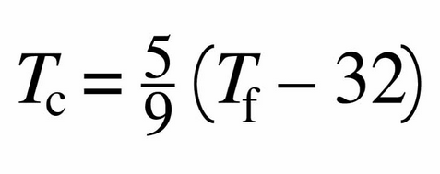
Which subjects do you use each formula in? What are they used to calculate?
S = D
T
D = M
V

Slide 3
Which subjects do you use each formula in? What are they used to calculate?
S = D
T
Speed = Distance ÷ Time
Used in PE, Science and Maths.
D = M
V
Converting degrees Farenheit to degrees Celcius.
Used in Science.
Density = Mass ÷ Volume
Used in Science and Maths.
Area of a trapezium.
Used in maths.
Circumference equals Pi times diameter
Used in D&T and maths.
Area of a circle equals Pi times radius squared.
Used in D&T and maths.

