Slide 1
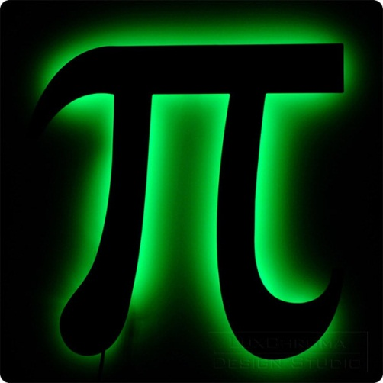
What’s special about these dates?
When the date is written in a certain way it gives it a new meaning.
4th May
14th March
4th May gives us the phrase, “May the 4th be with you!” Its similarity to “May the force be with you” makes it National Star Wars Day.
14th March when written “3.14” gives us the first 3 digits of Pi (∏) – hence National Pi Day.
But how well do you know the number Pi?
What subjects would you use it in?

Slide 2
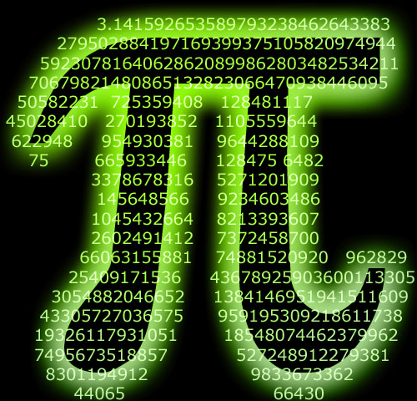
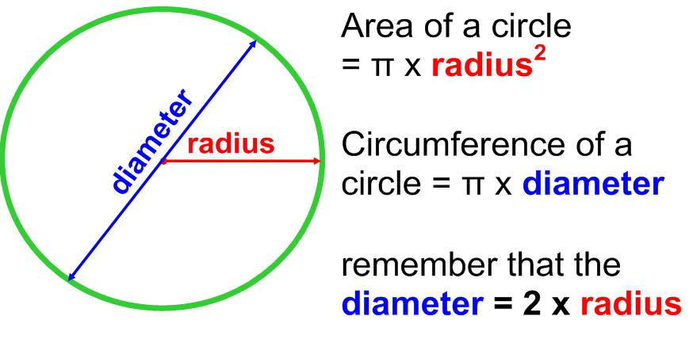
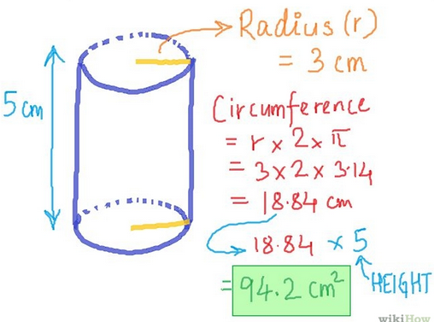
In school you’ll use Pi in…
…Mathematics – to work out the surface area and volume of spheres and cylinders.
…D&T – to work out the circumference and area of circles.
In honour of National Pi Day (3.14) we are launching a prize competition.
The next slide shows Pi to around 200 digits.
How many digits can you memorise it to?

