Slide 1
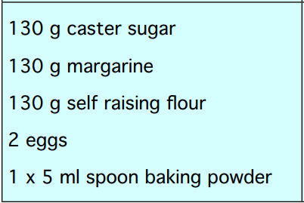
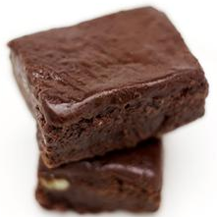
Numeracy and Food Technology
This is part of a recipe for a tray bake. It makes 12 cakes.
How much of each ingredient would you need to make the following amount of cakes?
24 cakes
48 cakes
6 cakes
18 cakes
HINT: 12 x ___ = 25

Slide 2
Numeracy and Food Technology
This is part of a recipe for a tray bake. It makes 12 cakes.
12
260 g
24
260 g
260 g
x2
4
2 x 5 ml

Slide 3
Numeracy and Food Technology
This is part of a recipe for a tray bake. It makes 12 cakes.
12
520 g
48
520 g
520 g
x4
8
4 x 5 ml

Slide 4
Numeracy and Food Technology
This is part of a recipe for a tray bake. It makes 12 cakes.
12
65 g
6
65 g
65 g
÷2
1
½ x 5 ml

Slide 5
Numeracy and Food Technology
This is part of a recipe for a tray bake. It makes 12 cakes.
12
195g
18
195 g
195 g
x1.5 (12+6=18)
3
1½ x 5 ml

