Slide 1
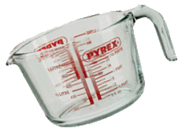
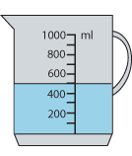
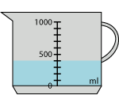
Numeracy and Food Technology
An important part of your food technology lessons is being able to read scales.
If you measure out ingredients wrong, whatever you’re making isn’t going to taste great.
How many of these scales can you read accurately?
500 ml
320 ml
400 ml

Slide 2
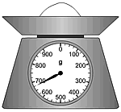
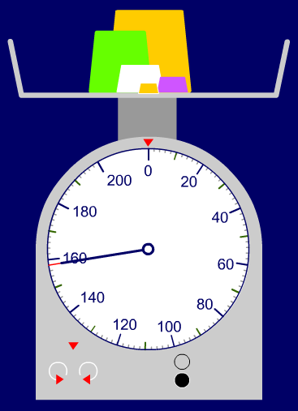
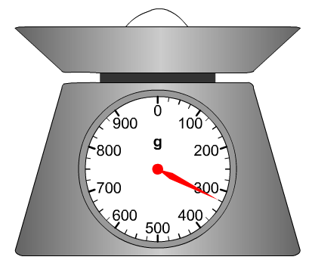
Numeracy and Food Technology
An important part of your food technology lessons is being able to read scales.
If you measure out ingredients wrong, whatever you’re making isn’t going to taste great.
How many of these scales can you read accurately?
675 g
325 g
158 g

