Slide 1
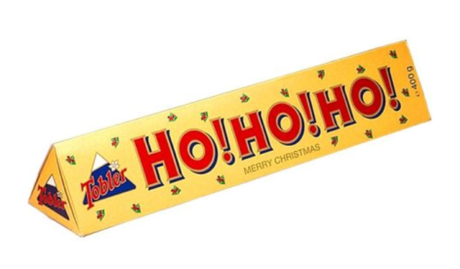
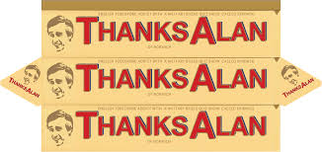
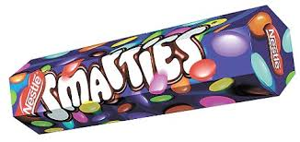
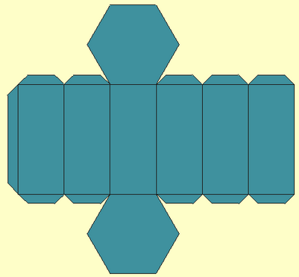
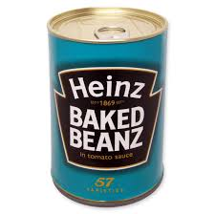
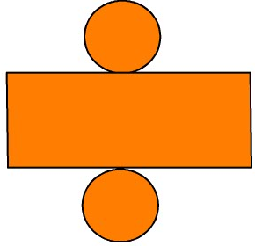
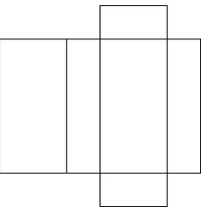
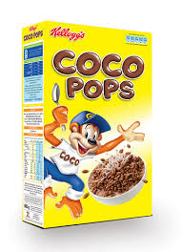
Numeracy and Graphics
In graphics you need to understand how to represent 3D objects in two dimensions.
A net is the 2D shape you would cut out that would fold up to make the 3D shape.
What would the net of the packaging of these products look like?
They are all prisms.
If you slice them along their length you end up with the same shape – this is called the cross section.
Cross section: Triangle
Cross section: Hexagon
Cross section: Circle
Do you notice anything they have in common?
What cross section does each shape have?
Cross section: Rectangle

