Slide 1
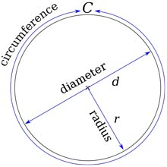
Engineering and 2D Design
Any job involving technical designs will require you to use formulae to work out measurements.
If you were designing rotating parts you would need to be able to work out the distance around the outside of a circle.
Any idea what this is called?
It’s called the circumference.
And its formula is:
Circumference = Pi x diameter

Slide 2
Not that kind of pie.
Pi (or ∏) is a special number:
3.14159265359….
It’s an irrational number.
Basically as far as we know it goes on forever.
There is a button on calculators for when you need to use Pi accurately to work out the circumference or area of a circle.
Circumference is pi times diameter….
Now that reminds me of a song.
Click here to play the song

