Slide 1
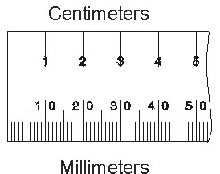
Construction workers
If you worked on a construction site you’d need numeracy on a day-to-day basis to do your job.
Measuring accurately would be an important part of your job.
Sometimes you would need to measure in centimetres and other times you would need to measure in millimetres.
But how would you change a measurement in centimetres to one in millimetres?
x 10
How many millimetres are there in a centimetre?
(Have a look at your ruler if you aren’t sure)
cm
mm
÷ 10

Slide 2
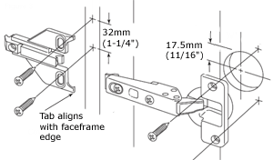
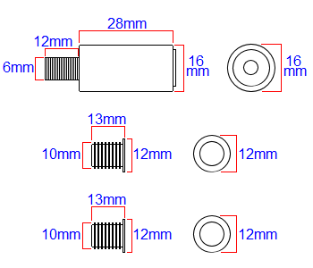
You are going to see a technical drawing of a hinge.
The measurements are given in centimetres.
What would they be in millimetres?
x 10
Screws and fixings are often measured in millimetres.
What would these measurements be in centimetres?
cm
mm
÷ 10
32mm
1.2cm
2.8cm
17.5mm
1.6cm
1.6cm
0.6cm
3.2 cm
1.75 cm
1.3cm
1.2cm
1.2cm
1 cm
1.3cm
Why do you think the measurements for a hinge would usually be given in millimetres rather than centimetres?
1.2cm
1.2cm
1 cm

