Slide 1
What do baking and maths have in common?
Proportion!
Recipes won’t always be for the amount of people you want to bake for.
That’s when proportion comes in useful. If your recipe is for 10 people and you wish to bake for 30, you use proportion to work out how much of each ingredient you need.

Slide 2
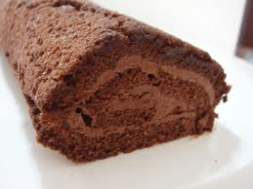
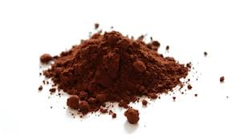
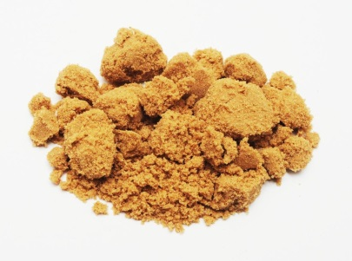
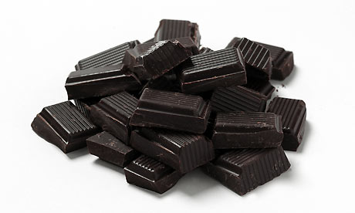
Chocolate Fudge Swiss Roll
What ingredients do you think you’d need? In what quantities?
To make enough Swiss Roll for 8 people you would need…
50 g cocoa powder
3 large eggs
80g muscovado sugar
100g dark chocolate
1 teaspoon vanilla extract
200 ml whipping cream
How much of each ingredient would you need for 4 people?
How much of each ingredient would you need for 16 people?
How much of each ingredient would you need for 12 people?

Slide 3
Chocolate Fudge Swiss Roll – how much for 4 people?
8 people
50 g cocoa powder
3 large eggs
80g muscovado sugar
100g dark chocolate
1 teaspoon vanilla extract
200 ml whipping cream
4 people
25 g cocoa powder
1 ½ large eggs
40g muscovado sugar
50g dark chocolate
½ teaspoon vanilla extract
100 ml whipping cream
Half it

Slide 4
Chocolate Fudge Swiss Roll – how much for 16 people?
8 people
50 g cocoa powder
3 large eggs
80g muscovado sugar
100g dark chocolate
1 teaspoon vanilla extract
200 ml whipping cream
16 people
100 g cocoa powder
6 large eggs
160g muscovado sugar
200g dark chocolate
2 teaspoon s vanilla extract
400 ml whipping cream
Double it

Slide 5
Chocolate Fudge Swiss Roll – how much for 12 people?
8 people
50 g cocoa powder
3 large eggs
80g muscovado sugar
100g dark chocolate
1 teaspoon vanilla extract
200 ml whipping cream
4 people
25 g cocoa powder
1 ½ large eggs
40g muscovado sugar
50g dark chocolate
½ teaspoon vanilla extract
100 ml whipping cream
12 people
75 g cocoa powder
4 ½ large eggs
120g muscovado sugar
150g dark chocolate
1½ teaspoon vanilla extract
300 ml whipping cream

