Slide 1
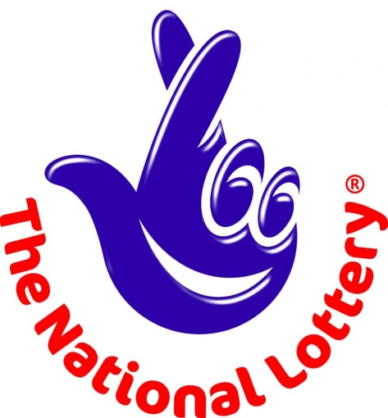
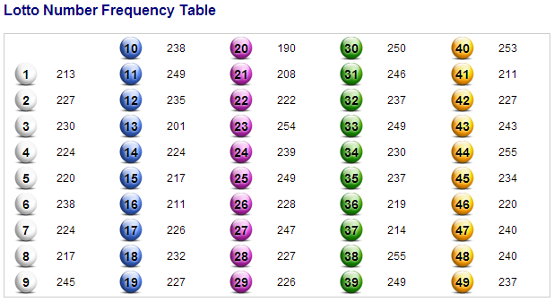
The National Lottery
Do people in your family buy scratch cards or lottery tickets?
How often do they win?
How would you describe their chances of winning each time they buy a ticket?
This table shows how frequently different numbers have come up in recent draws.
Do you think the lottery is biased?

Slide 2
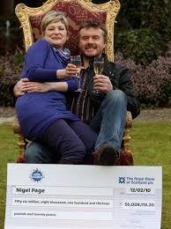
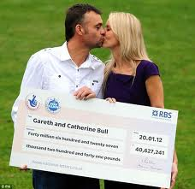
So what are your chances of winning the National Lottery?
How many different combinations of 6 numbers do you think there are?
There are 13,983,816 different combinations of 6 numbers you could pick. With each ticket now costing £2, that means on average you would have to spend around £28 million to win the jackpot.
Okay, so that’s not very likely. How about winning £10? Well there are 20 different combinations of 3 numbers from every 6 you pick. It works out that you would have to buy 57 lottery tickets on average to win £10, at a cost of £114.

Slide 3
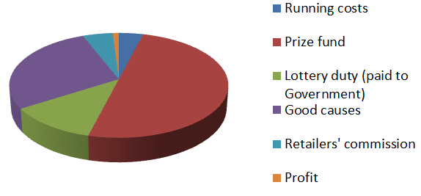
Camelot claim to run the most cost-efficient major lottery in Europe. This is where they say the money goes.
Where does the largest percentage of revenue go?
Who gets just over a quarter of the revenue?
What do you think about the percentage of the money that is actually profit for Camelot?
£1.82 billion pounds for good causes a year.
Were you close?
Camelot say that on average they generate £35 million for good causes each week. Can you estimate what that works out as a year?
£65 million pounds profit for Camelot each year.
Based on that can you estimate their annual profit from the lottery?

