Slide 1
Methods of payment quiz
Question 1
When you buy a car, there are different ways you can choose to pay for it. Which way does the following describe?
Advantages
You can buy something when you don’t have the money immediately available
You can spread out your repayments over time
Disadvantages
Can have very high interest rates. If you don’t keep up on your repayments you can quickly find yourself in debt.
The companies or banks that offer the lowest interest rates won’t offer everyone this method of payment.
A - Cash
B - Credit card
C - Finance agreement
D - Personal Loan

Slide 2
Methods of payment quiz
Question 2
Which method of payment does the following describe?
Advantages
You pay back in monthly fixed amounts which allows you to plan your budget
You are likely to be able to get a more expensive car in better condition than you would otherwise
You can keep upgrading your vehicle at regular intervals
Disadvantages
At the end of the day you do not own the car, instead you will be offered the opportunity to buy it at a cheaper price
You will still have to hand over a deposit for the vehicle
A - Cash
B - Credit card
C - Finance agreement
D - Personal Loan

Slide 3
Methods of payment quiz
Question 3
Which method of payment does the following describe?
Advantages
Avoids the risk of credit card fraud
You can keep better track of your finances
You are less likely to overspend
Disadvantages
It limits what you can spend to the amount in your bank account
You have to pay the whole amount at once and can’t spread out your payments
You are at risk of theft
You do not have an automatic electronic record of where you have spent your money
A - Cash
B - Credit card
C - Finance agreement
D - Personal Loan

Slide 4
Methods of payment quiz
Question 4
Which method of payment does the following describe?
Advantages
Some businesses only accept these payments
Your bill gives you a clear record of where you have spent your money
You get consumer protection on your transactions
It is a quick way to borrow money
Disadvantages
If you don’t clear your bill each month, interest payments will build up. It is easy to borrow too much
There may be hidden fees – for example for late payments
A - Cash
B - Credit card
C - Finance agreement
D - Personal Loan

Slide 5
Methods of payment quiz - ANSWERS
Question 1
When you buy a car, there are different ways you can choose to pay for it. Which way does the following describe?
Advantages
You can buy something when you don’t have the money immediately available
You can spread out your repayments over time
Disadvantages
Can have very high interest rates. If you don’t keep up on your repayments you can quickly find yourself in debt.
The companies or banks that offer the lowest interest rates won’t offer everyone this method of payment.
D - Personal Loan

Slide 6
Methods of payment quiz - ANSWERS
Question 2
Which method of payment does the following describe?
Advantages
You pay back in monthly fixed amounts which allows you to plan your budget
You are likely to be able to get a more expensive car in better condition than you would otherwise
You can keep upgrading your vehicle at regular intervals
Disadvantages
At the end of the day you do not own the car, instead you will be offered the opportunity to buy it at a cheaper price
You will still have to hand over a deposit for the vehicle
C - Finance agreement

Slide 7
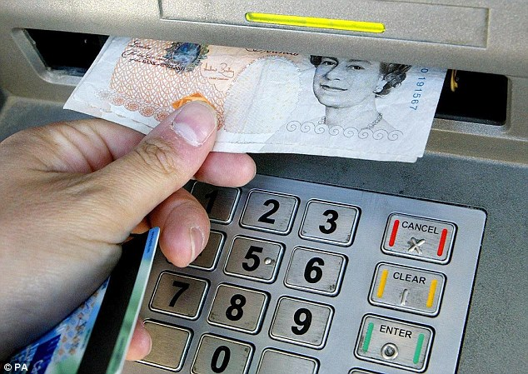
Methods of payment quiz - ANSWERS
Question 3
Which method of payment does the following describe?
Advantages
Avoids the risk of credit card fraud
You can keep better track of your finances
You are less likely to overspend
Disadvantages
It limits what you can spend to the amount in your bank account
You have to pay the whole amount at once and can’t spread out your payments
You are at risk of theft
You do not have an automatic electronic record of where you have spent your money
A - Cash

Slide 8
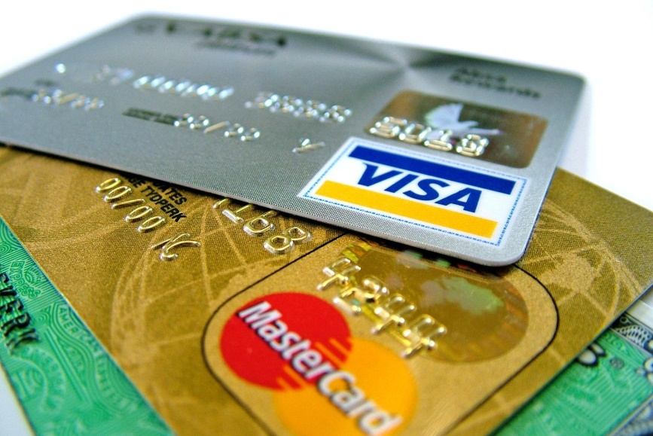
Methods of payment quiz - ANSWERS
Question 4
Which method of payment does the following describe?
Advantages
Some businesses only accept these payments
Your bill gives you a clear record of where you have spent your money
You get consumer protection on your transactions
It is a quick way to borrow money
Disadvantages
If you don’t clear your bill each month, interest payments will build up. It is easy to borrow too much
There may be hidden fees – for example for late payments
B - Credit card

