Slide 1
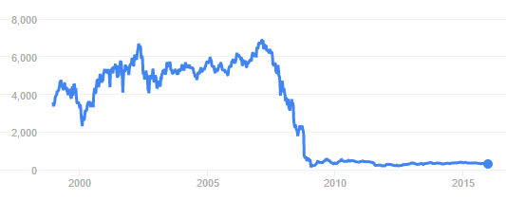
Managing risk: stocks, shares and investments
Stocks and shares allow you to buy a stake in the ownership of a company.
That means you are entitled to a share of the company’s earnings, but also to a share of its losses.
8000
6000
4000
2000
0
2000
2005
2010
2015
This graph shows how the price of shares (in pence) of the Royal Bank of Scotland have changed over the last 15 years.
If you had bought 100 shares when the price was at a maximum (around 2007), approximately how much would you have lost if you still had the shares now?
If you still had the shares, would you sell or hold onto them?

Slide 2
Managing risk: stocks, shares and investments - ANSWER
Stocks and shares allow you to buy a stake in the ownership of a company.
That means you are entitled to a share of the company’s earnings, but also to a share of its losses.
8000
6000
4000
2000
0
2000
2005
2010
2015
In February 2007, the maximum price of the shares was approximately 7000p or £70.
If you bought 100 shares at this price it would have cost you
100 x £70 = £7000
In 2015 the price of the shares was approximately 300p or £3. Your 100 shares would have then been worth
100 x £3 = £300
That’s a loss of £7000 - £300 = £6700

