Slide 1
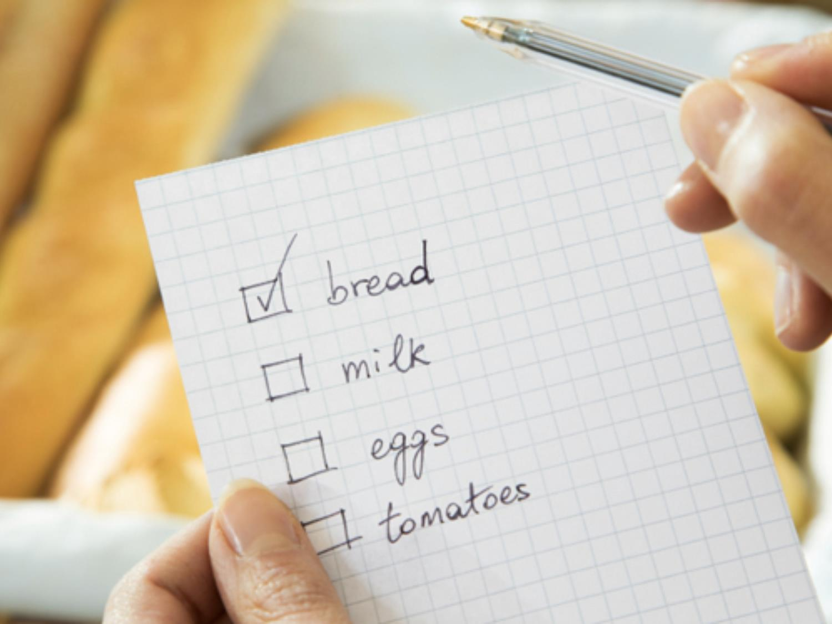
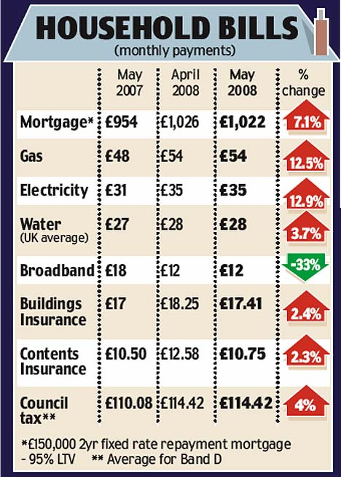
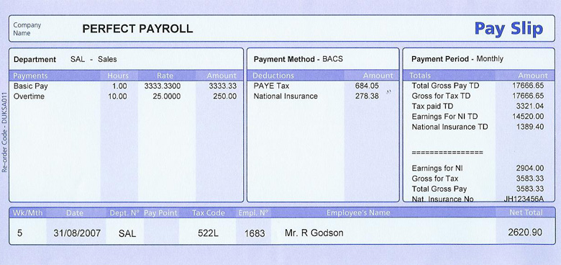
Budgets
A budget is a plan for your money. Use the following pieces of information to work out how much money you would have left to spend a month after you had paid your bills.
What would you need to spend some of it on? How much would you spend on these things? What would you do with the left over money?

Slide 2
Budgets – POSSIBLE ANSWER
Using the monthly bills for 2008,
Total bills = £1022 + £54 + £35 + £28 + £12 + £17.41 + £10.75 + £114.42 = £1293.58
Net income – Total bills = £2620.90 - £1293.58 = £1327.32
Food (£300?) Petrol (£350?) Mobile (£40?) Car insurance/tax (£60?)

