Slide 1
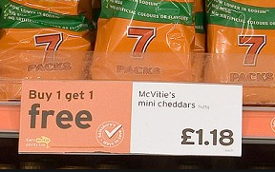
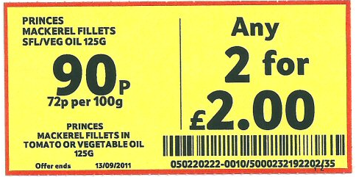
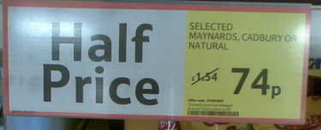
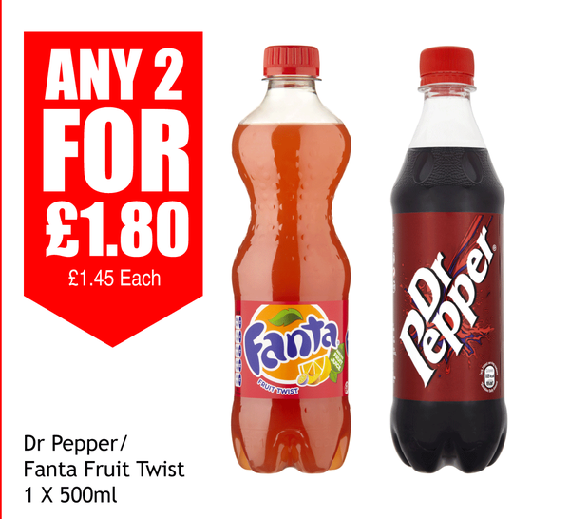
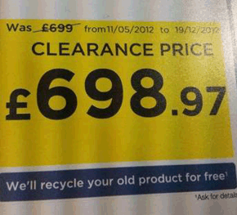
Being a clever consumer
What’s wrong with these offers?
How much would 3 packs of mini cheddars cost you?
How much would 3 bottles of soft drink cost you?

Slide 2
Being a clever consumer - ANSWERS
What’s wrong with these offers?
How much would 3 packs of mini cheddars cost you?
£1.18 + £1.18 = £2.36
It’s cheaper not to use the offer
How much would 3 bottles of soft drink cost you?
Half of £1.54 is actually 77p
£1.80 + £1.45 = £3.25
There is only a reduction of 3p!

