Slide 1
Investment Banking
One way to save is to invest your money in shares.
Can you explain what shares are?
The photo is of the New York Stock Exchange where shares are bought and sold every day.
Shares are the equal parts that the value of a company is divided into.
If you own shares in a company you are entitled to a percentage of any profit it makes.
The more shares you have, the greater the share of the profit.
Investment bankers are paid to buy and sell shares for you in order to make you more money.
So is it always a good idea to buy shares?
What might affect whether you buy shares in a company or not?

Slide 2
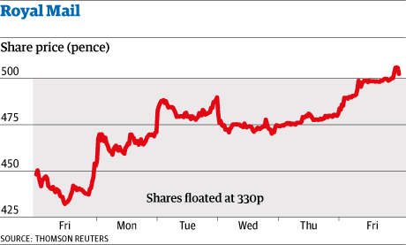
On Friday 11th October 2013 the Royal Mail was “floated on the stock market.” The Government decided to sell shares in it so that it could be privately owned.
What happened to the share price over the week that followed?
On which day did the share price change the least?
When would have been the best time to buy shares? If you had shares would you be thinking of selling them yet?

