Slide 1
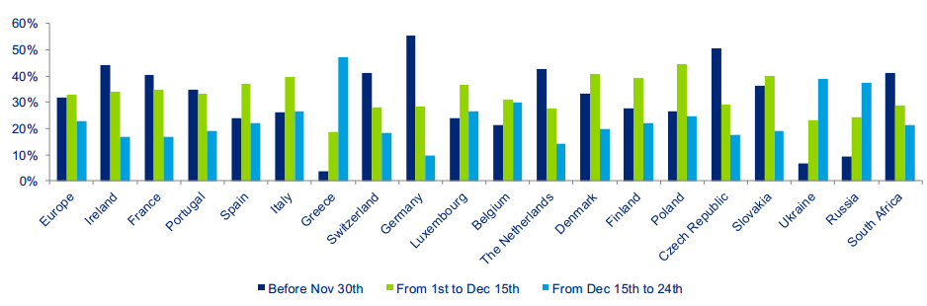
Deloitte does an annual survey of Christmas spending. The graph below shows the results from the question,
“When do you expect to purchase the majority of your gifts?”
Before November 30th
From 1st to
Dec 15th
From Dec 15th
to 24th
Give 3 findings from the survey.

Slide 2
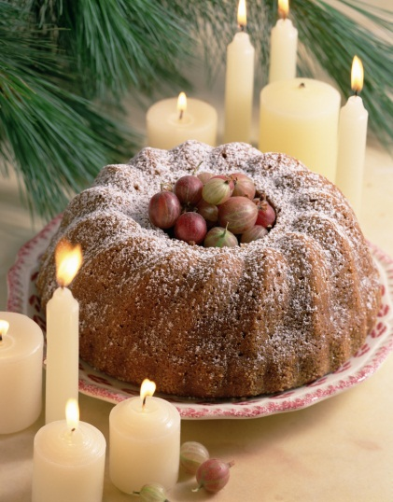
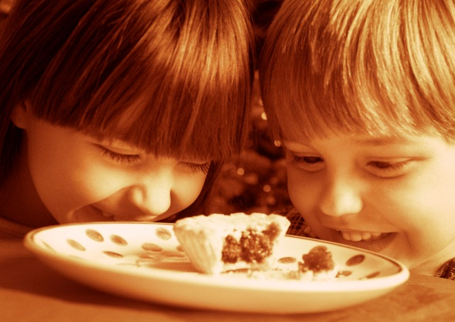
There is an exchange rate of €1 = £0.83
Deloitte also found in their 2012 survey that the average household in Ireland spent €288.30 on food and drink in the build up to Christmas.
How much (roughly) is €288.30 in pounds?
288.30 x 0.8 = £238.45
Were you close?

Slide 3

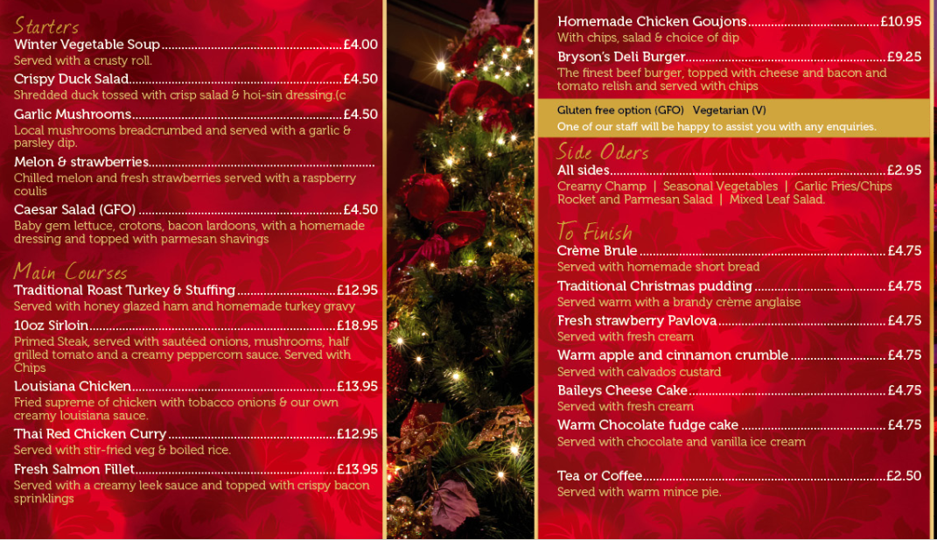
Choose a starter, a main course and a desert.
How much would your meal cost?
Can you add on a 10% service charge?

