Slide 1

APR Quiz
Question 1
You’ll see APR listed whenever you are able to borrow money, but what does APR stand for?
A
Annual Percentage Rate
B
Automatic Percentage Rise
C
Additional Percentage Rise
D
Annual Performance Rise
Key Words
Additional – how much extra there is
Annual – yearly
Percentage – how many parts out of 100
Performance – how well something is done
Rate – the speed at which something happens
Rise – how much something goes up by

Slide 2

APR Quiz
Question 2
APR is how much extra you will have to pay back each year on any money you borrow. It is given as a percentage. For example an APR of 1% would mean you pay back an extra 1% on any money you borrow each year. How can you work out 1% of a number?
A
Divide it by 10
B
Multiply it by 10
C
Divide it by 100
D
Multiply it by 100

Slide 3
APR Quiz
Question 3
An APR of 5% would mean you pay back an extra 5% on any money you borrow each year. Which of these is NOT a way to work out 5% of a number?
A
Divide it by 2 to find 50%, then divide it by 10
B
Divide it by 5 to find 5% directly
C
Divide it by 100 to find 1%, then multiply it by 5
D
Divide it by 10 to find 10%, then halve it

Slide 4
APR Quiz
Question 4
A car loan is offered at 8% APR. If you take out a loan on a car costing £1000 and don’t pay anything back, how much will you owe after one year?
A
£1008
B
£1080
C
£1800
D
£8000

Slide 5
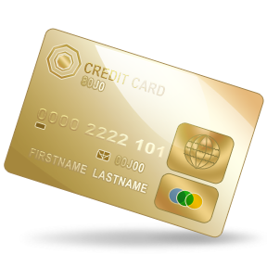
APR Quiz
Question 5
A credit card is offered at 16% APR. If you spend £1000 on your credit card and don’t pay anything back, how much will you owe after one year?
A
£1160
B
£1600
C
£1016
D
£16000

Slide 6
APR Quiz
Question 6
A pay day loan is offered at 3100% APR. If you borrow £1000 and don’t pay anything back, how much will you owe after one year?
A
£1320
B
£31000
C
£1031
D
£32000

Slide 7
APR Quiz - ANSWERS
Question 1
You’ll see APR listed whenever you are able to borrow money, but what does APR stand for?
A
Annual Percentage Rate
Annual : Yearly
Percentage : The amount (in parts out of 100)
Rate : The speed at which something happens
Basically a measure of how much extra you have to pay back per year.

Slide 8
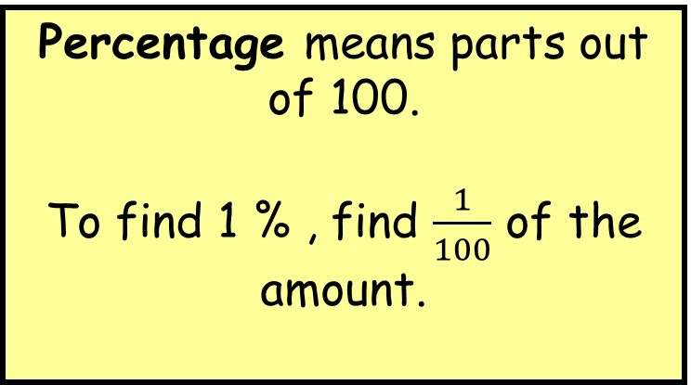
APR Quiz
Question 2
APR is how much extra you will have to pay back each year on any money you borrow. It is given as a percentage. For example an APR of 1% would mean you pay back an extra 1% on any money you borrow each year. How can you work out 1% of a number?
Percentage means parts out of 100.
To find 1 % , find $\frac{1}{100}$ of the amount.
C
Divide it by 100

Slide 9
APR Quiz
Question 3
An APR of 5% would mean you pay back an extra 5% on any money you borrow each year. Which of these is NOT a way to work out 5% of a number?
A
Divide it by 2 to find 50%, then divide it by 10
B
Divide it by 5 to find 5% directly
C
Divide it by 100 to find 1%, then multiply it by 5
D
Divide it by 10 to find 10%, then halve it
If you divide a number by 5, you actually find 20%
[100% ÷ 5 = 20%]

Slide 10
APR Quiz
Question 4
A car loan is offered at 8% APR. If you take out a loan on a car costing £1000 and don’t pay anything back, how much will you owe after one year?
B
£1080
8% of 1000
1000 ÷ 100 x 8
= 80
Then add it on to your starting amount:
1000 + 80 = £1080

Slide 11
APR Quiz
Question 5
A credit card is offered at 16% APR. If you spend £1000 on your credit card and don’t pay anything back, how much will you owe after one year?
A
£1160
16% of 1000
1000 ÷ 100 x 16
= 160
Then add it on to your starting amount:
1000 + 160 = £1160

Slide 12
APR Quiz
Question 6
A pay day loan is offered at 3100% APR. If you borrow £1000 and don’t pay anything back, how much will you owe after one year?
3100% of 1000
1000 ÷ 100 x 3100 = 31000
Then add it on to your starting amount:
1000 + 31000= £32000
D
£32000

