Slide 1
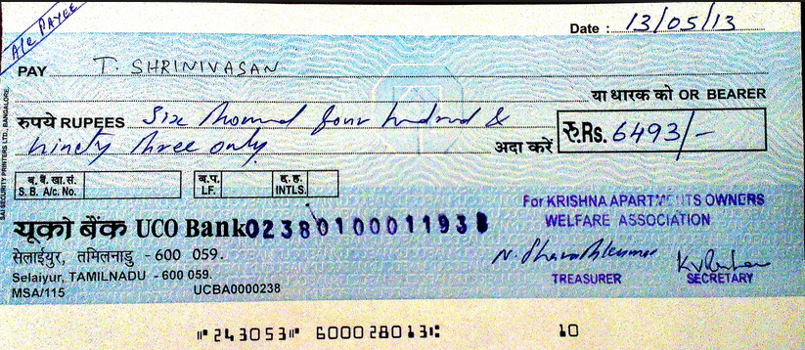
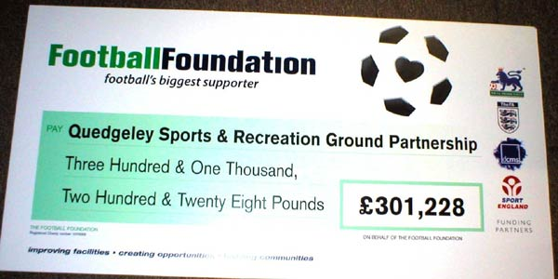
Cheques
What is a cheque used for?
How would you write the amounts shown in words?

Slide 2
Profit and loss accounts
Paperclip figures for the last month.
Sales of:
Stationary £250,000
Computers £1,456,000
Cost of these sales £787,000
Wages and salaries £45,000
Rent and Insurance £87,900
Light, heat and power £32,430
Telephone/Broadband £6,970
Who might use a profit and loss account?
Complete the table using the figures shown.
Use the following information to help you.
Gross = Total - Cost of
profit sales sales
Net = Gross - Expenses
profit profit
Cost of sales
Net profit

Slide 3
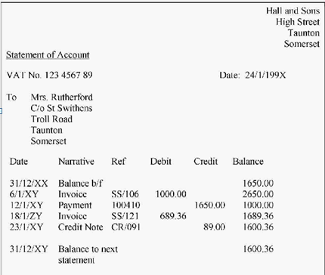
Statements of accounts
What is a statement of account?
What does “the balance” mean?
Work out the missing balances.

Slide 4
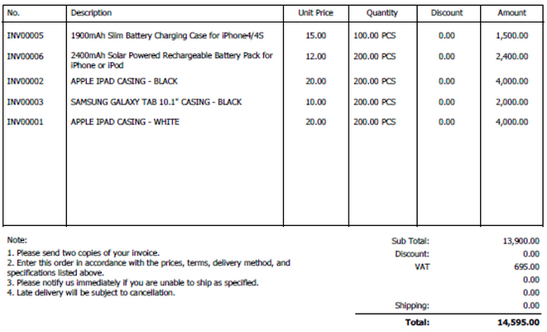
Purchase Orders
What is a purchase order?
Work out the total for each item. What is the sub total?
What is VAT?
[VAT is currently charged at 20% in the UK]
Work out the VAT.
What is the total for the order?
2780.00
16,680.00

Slide 5
Invoices
What is an invoice?
Work out the total value for each item.
What is the sub total?
What is VAT?
Calculate the VAT.
What is the final total?
191.05
(@20%) 38.21
229.26

Slide 6
Credit notes
What is credit note?
Work out the total value for each item.
What is the sub total?
What is VAT?
Calculate the VAT.
What is the final amount to be refunded?

Slide 7
Gross profit margin
The gross profit margin for a business gives (as a percentage) how much profit a business has made in relation to the sales it has made.
The higher the better. (N.B. Gross profit = Sales turnover – cost of sales)
Work out the gross profit margin for these companies.
Which company did the best?
Beatbox stereos had a total sales turnover of £32,420 in 2013 yielding a gross profit of £15,600.
Skyscraper smoothies had a total sales turnover of £2,402 in 2012 which resulted in a gross profit of £1,840.
Trekquick trainers had a total sales turnover of £142,020 in 2013 yielding a gross profit of £52,149.

Slide 8
Net profit margin
The net profit margin for a business gives (as a percentage) how much net profit a business has made in relation to the sales it has made. The higher the better. (N.B. Net profit = Gross profit - expenses)
Work out the net profit margin for these companies.
Which company did the best?
Beatbox stereos had a total sales turnover of £32,420 in 2013 yielding a net profit of £1,200.
Skyscraper smoothies had a total sales turnover of £2,402 in 2012 which resulted in a net profit of £630.
Trekquick trainers had a total sales turnover of £142,020 in 2013 yielding a net profit of £12,149.
Which would be higher, the net profit margin or the gross profit margin?

Slide 9
Return on Capital Employed
This works out the amount of net profit that has been made as a percentage of the amount of money used by the business.
This is a good way of comparing competitors; ideally ROCE should work out about 20-30%.
Work out the ROCE for these companies:
A business has a net profit of £2.2 million and a capital employed of £7.6 million. What is its ROCE?
A business has a net profit of £708, 000 and a capital employed of £1.5 million. What is its ROCE?

Slide 10
Liquidity ratios – current ratio
Liquidity is the ability of a business to turn current assets into cash in order to pay off short term debt.
The current ratio indicates how many current assets they have compared to current liabilities. (Should be between 1.5 and 2) It shows how easily a business can pay its debts.
Answer the following questions:
When a business calculates its assets (including stock it is holding and cash in its accounts), it finds it has current assets of £4,235. Its current liabilities, including all money owed, total £2,353. What is its current ratio?
You have £14 in your pocket but owe your friend £9.50. What is your current ratio?
If a company has a current ratio of one, what does this mean? How about if it had a current ratio less than one?

Slide 11
Liquidity ratios – acid test ratio
Liquidity is the ability of a business to turn current assets into cash in order to pay off short term debt.
The acid test ratio indicates the liquidity of a business but doesn’t take into account stock. It should be at least 1.
Stock can be difficult to sell of quickly or can become out of date meaning it can’t be used to pay off debt.
A business has current assets totalling £5320. Of them the stock is worth £3,430. It owes its suppliers £2500. What is its acid test ratio? What does this mean in practical terms for the business?
A business has current assets worldwide totalling £2.35 million. Its stock is worth £1.93 million. It owes £175,230. What is its acid test ratio? How do you think the business is doing?

