Slide 1
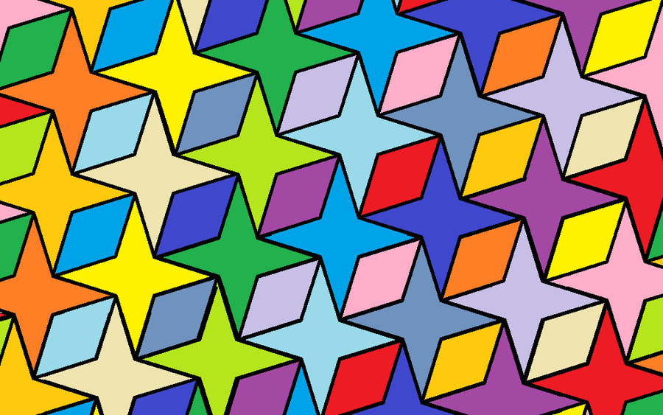
Tessellations
A tessellation is the tiling of a plane using one or more geometric shapes.
Any idea what a plane is?
What geometric shapes do you know?
In maths a plane refers to a flat surface. Examples of geometric shapes are squares, hexagons and triangles.
An important part of any tessellation is that there must be no gaps or overlapping shapes.

Slide 2
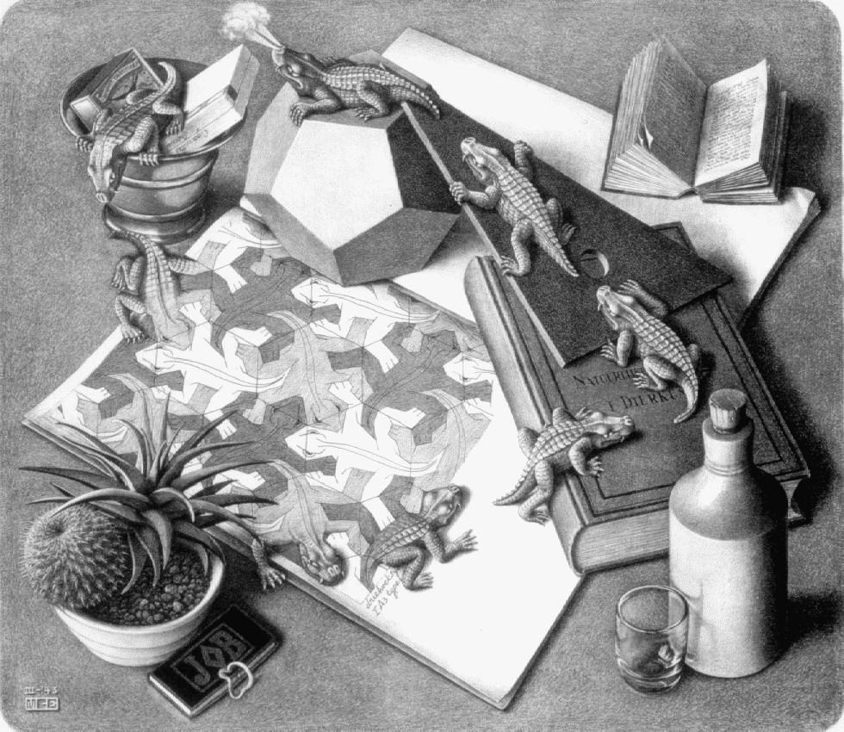
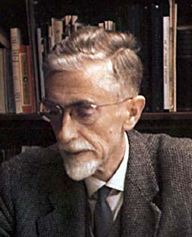
M. C. Escher (1898–1972) was a Dutch graphic artist who was inspired by mathematics to create designs using tessellations.
Notice how this “lizard” shape is used in the picture. It is repeated throughout the design on the piece of paper, leaving no gaps between the lizards.

Slide 3
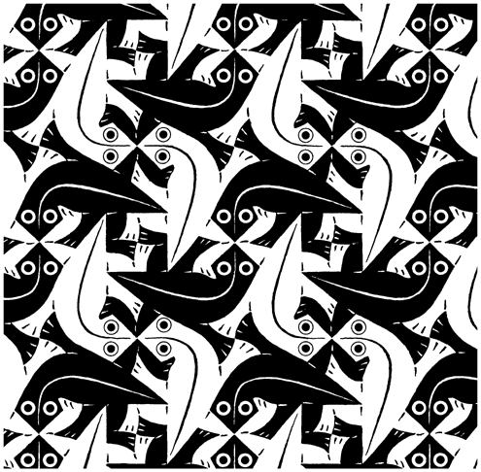
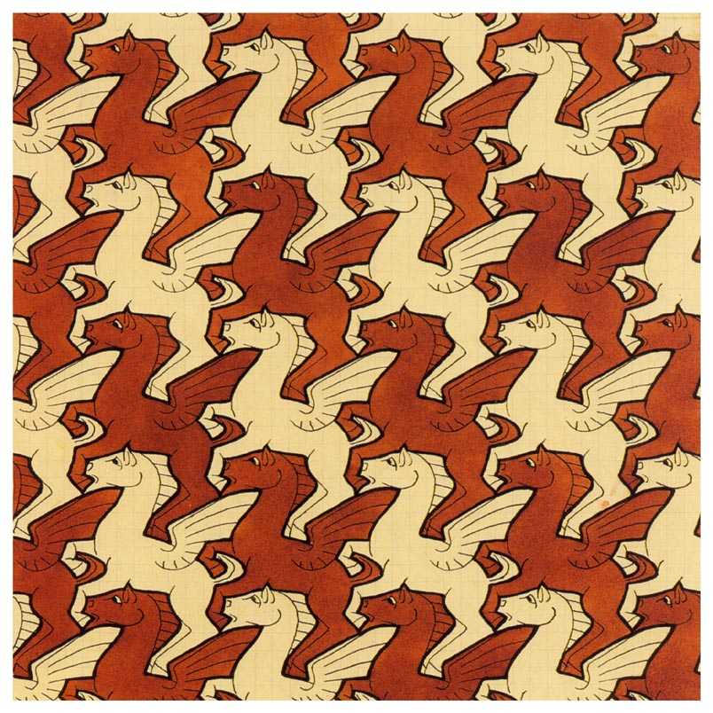
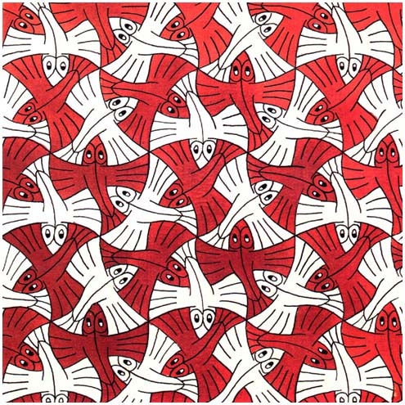
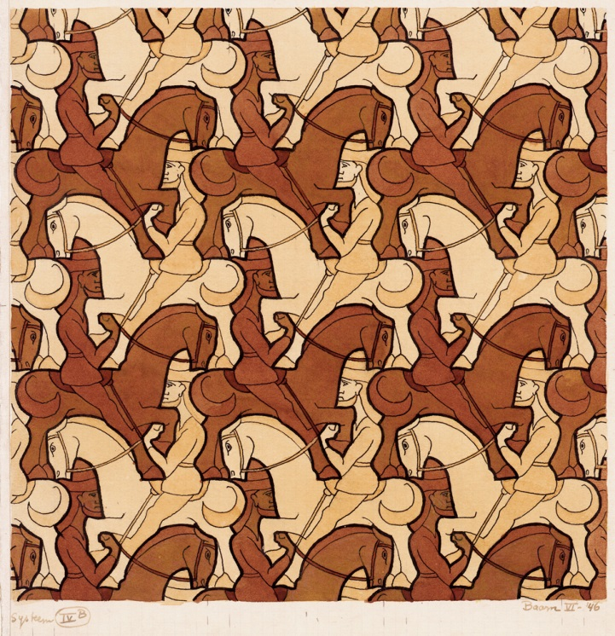
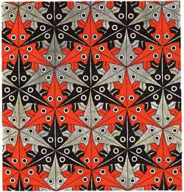
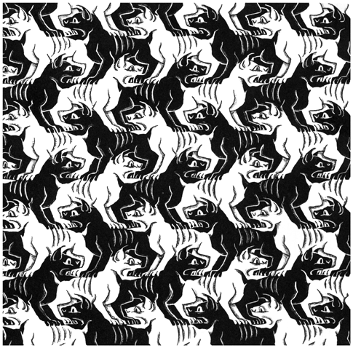
These are just a few of the tessellations Escher produced…

Slide 4
Which of these shapes do you think would tessellate?
(In order to tessellate the shapes must fit together without overlapping and without leaving gaps between them.)
Triangle
Square
Trapezium
Rectangle
Regular pentagon
Regular hexagon
Regular octagon
Parallelogram

Slide 5
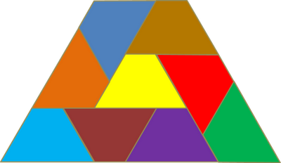
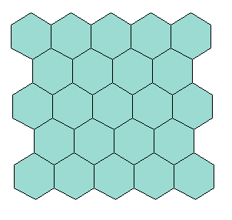
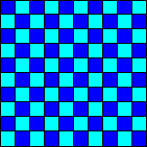
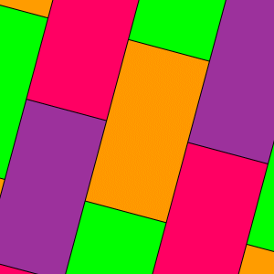

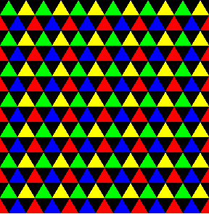
They all tessellate apart from the regular pentagon and regular octagon.

